Slide 1
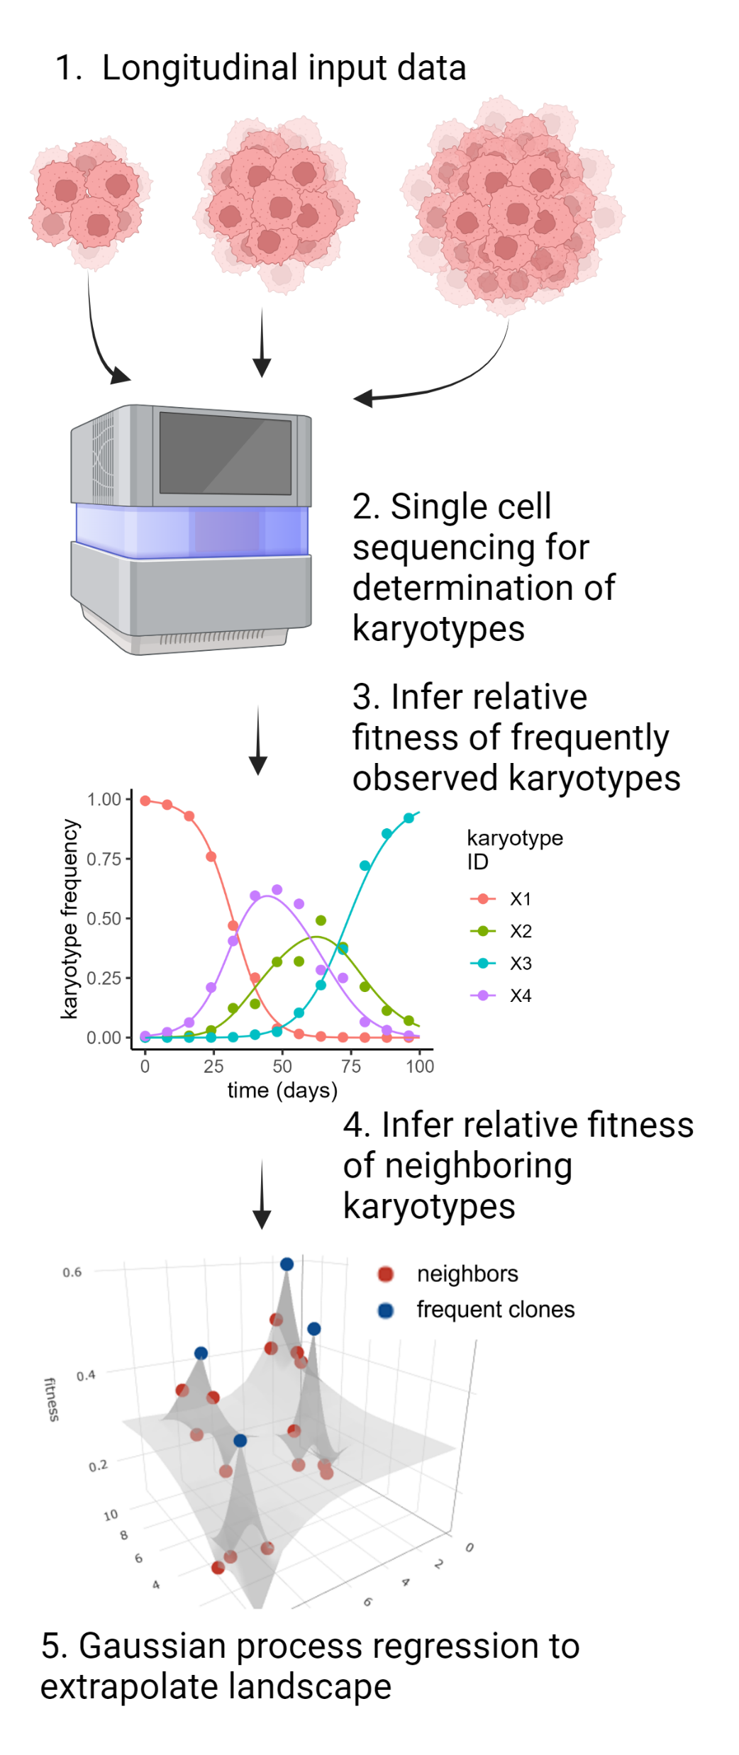
ALFA-K uses longitudinal, single-cell karyotype frequency data to infer a karyotype fitness landscape. The dynamics of “frequent karyotypes” (those that are represented in the data in large numbers) are used to estimate their relative fitness. Then, these fitness estimates are extrapolated to produce fitness estimates of karyotypes that are at low or zero frequency in the input data.
We also present an agent based model of karyotype evolution (detail in methods and probably supplemental figure). In this paper our ABM is used in two contexts. Firstly, randomly generated fitness landscapes are used as inputs to the ABM and subsequent outputs from the ABM are used to train ALFA-K. Then the input landscape and the inferred landscape are compared to validate the accuracy of ALFA-K.
In the second context, in-vitro or in-vivo data from Salehi et. al. are used to train ALFA-K. The inferred landscapes are used as inputs to the ABM, and predicted karyotype evolution from the ABM is compared to withheld in-vitro or in-vivo data. This aims to validate the ability of ALFA-K to predict karyotype evolution on real data.
A
B
compare
Random landscape
Inferred landscape
ABM
ALFA-K
C
Salehi data
ALFA-K
Inferred landscape
compare
ABM
D) Applications

Slide 2
The ALFA-K methodology predicts single-cell karyotype evolution using longitudinal data as input. Sequencing data from individual cells is used to identify temporal changes in karyotype frequency. The method estimates the fitness of common karyotypes from changes in their observed frequencies and extends these estimates to rarer ones, constructing a fitness landscape via Gaussian process regression (A).
An accompany Agent-Based Model (ABM) is presented which simulates karyotype evolution across random or real data-driven fitness landscapes. As an initial validation, ALFA-K is trained and tested exclusively on ABM output (B). Then its accuracy is tested against real data from cell culture and PDX passaging experiments (C). Finally, ALFA-K predicted landscapes are analysed to derive insights about the nature of selection in chromosomally unstable cell populations (D).

Slide 3
Devote an entire figure to the performance metrics.

Slide 4
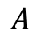
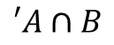
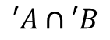
K
A
B
d1 | d2 | d3 | d4 | d5 | f | y
0.02 | 0.2 | 0.03 | 0.1 | 0.01 | 0.8 | TRUE
$$A$$
$$′A∩B$$
$$′A∩′B$$

Slide 5
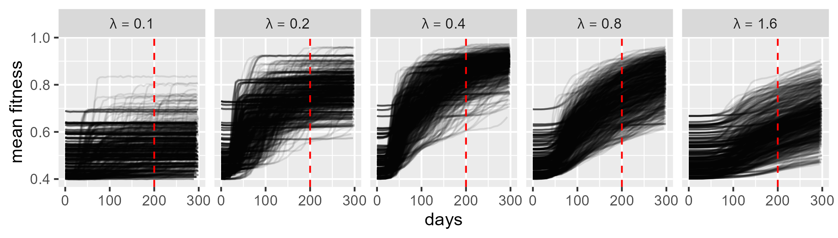
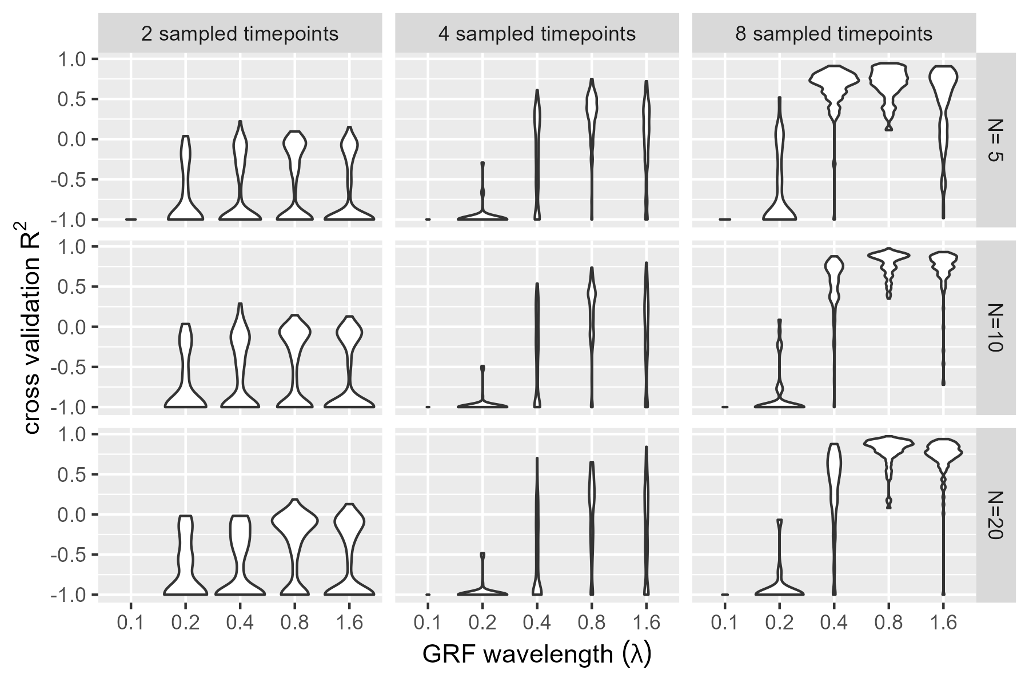
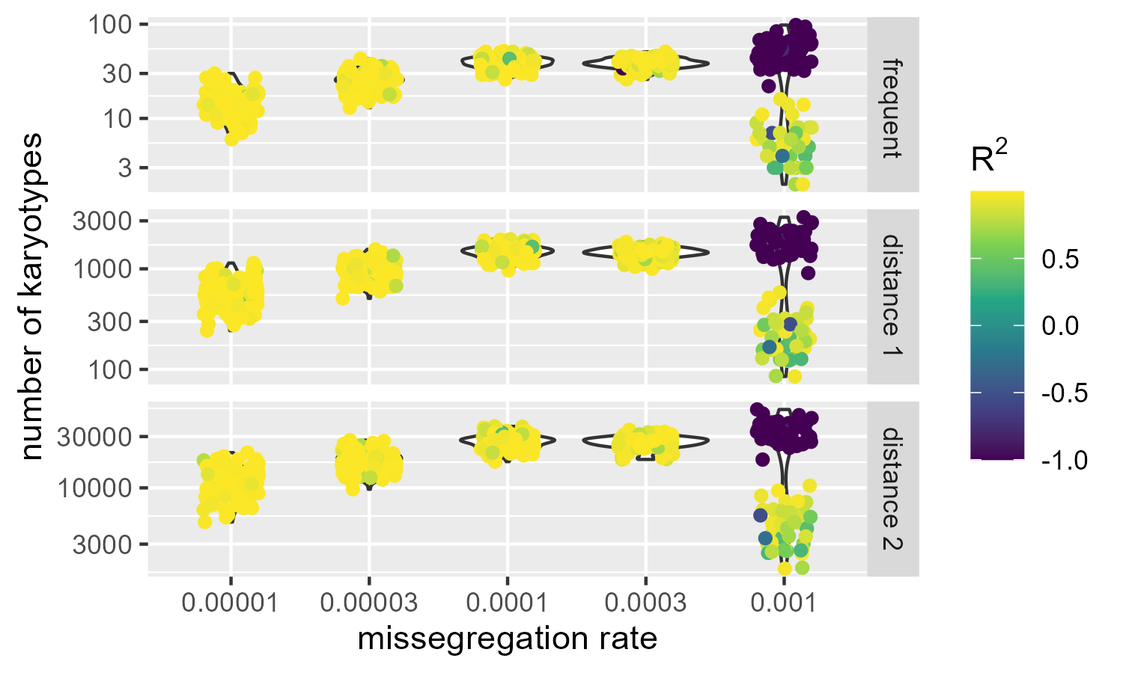
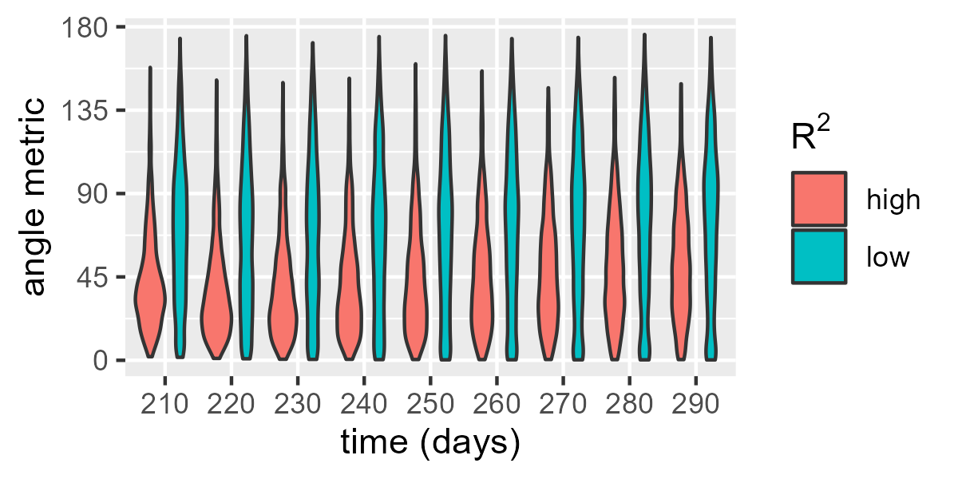
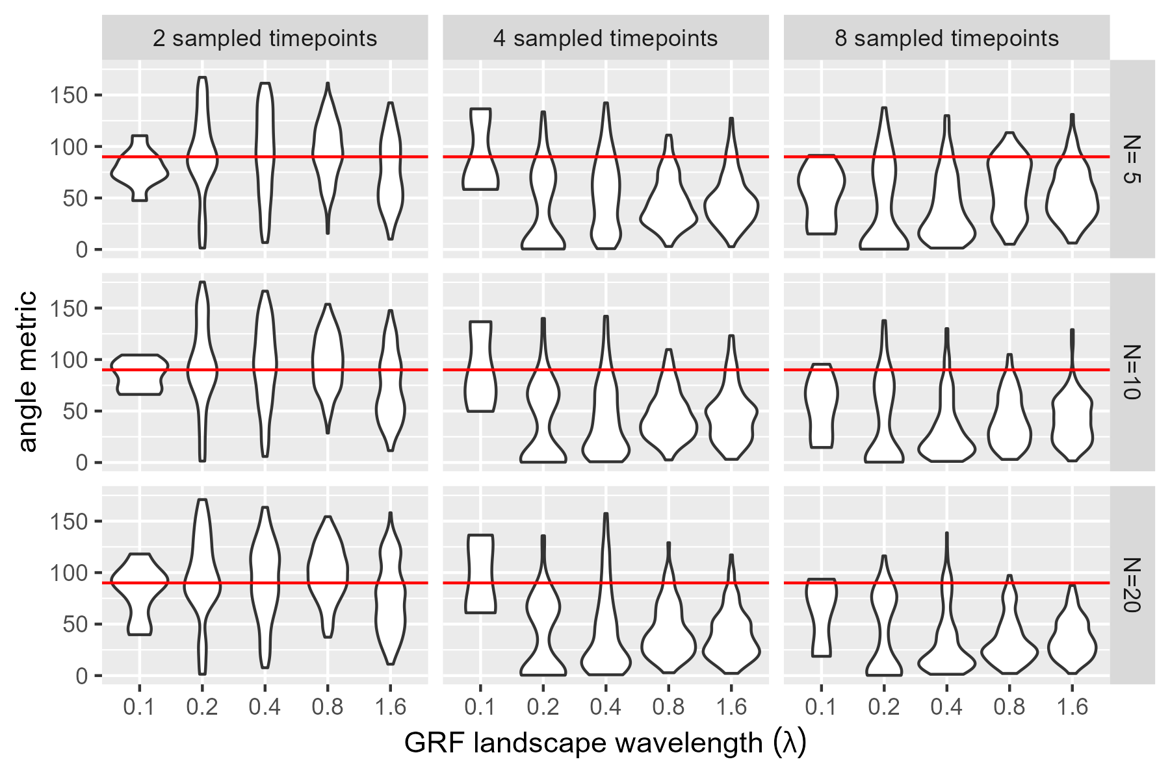
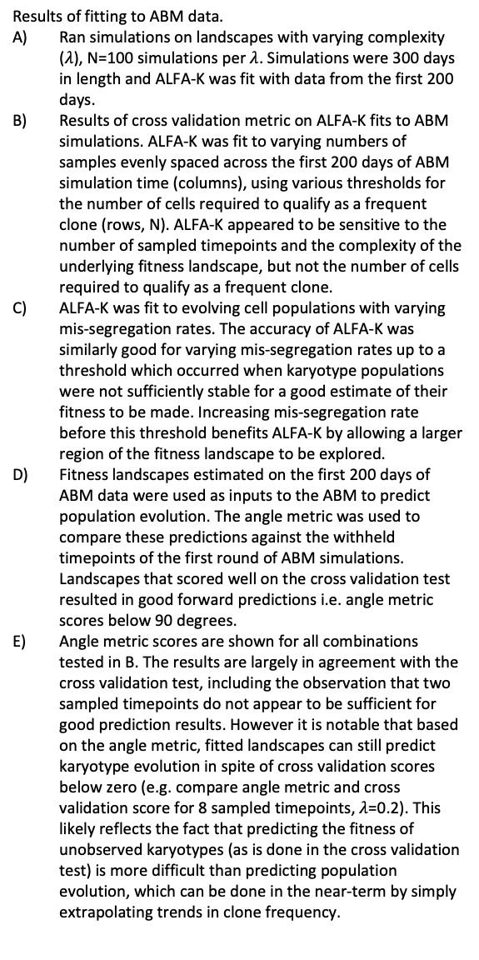
Results of fitting to ABM data.
Ran simulations on landscapes with varying complexity ($λ$), N=100 simulations per $λ$. Simulations were 300 days in length and ALFA-K was fit with data from the first 200 days.
Results of cross validation metric on ALFA-K fits to ABM simulations. ALFA-K was fit to varying numbers of samples evenly spaced across the first 200 days of ABM simulation time (columns), using various thresholds for the number of cells required to qualify as a frequent clone (rows, N). ALFA-K appeared to be sensitive to the number of sampled timepoints and the complexity of the underlying fitness landscape, but not the number of cells required to qualify as a frequent clone.
ALFA-K was fit to evolving cell populations with varying mis-segregation rates. The accuracy of ALFA-K was similarly good for varying mis-segregation rates up to a threshold which occurred when karyotype populations were not sufficiently stable for a good estimate of their fitness to be made. Increasing mis-segregation rate before this threshold benefits ALFA-K by allowing a larger region of the fitness landscape to be explored.
Fitness landscapes estimated on the first 200 days of ABM data were used as inputs to the ABM to predict population evolution. The angle metric was used to compare these predictions against the withheld timepoints of the first round of ABM simulations. Landscapes that scored well on the cross validation test resulted in good forward predictions i.e. angle metric scores below 90 degrees.
Angle metric scores are shown for all combinations tested in B. The results are largely in agreement with the cross validation test, including the observation that two sampled timepoints do not appear to be sufficient for good prediction results. However it is notable that based on the angle metric, fitted landscapes can still predict karyotype evolution in spite of cross validation scores below zero (e.g. compare angle metric and cross validation score for 8 sampled timepoints, $λ$=0.2). This likely reflects the fact that predicting the fitness of unobserved karyotypes (as is done in the cross validation test) is more difficult than predicting population evolution, which can be done in the near-term by simply extrapolating trends in clone frequency.
A
B
C
D
E

Slide 6
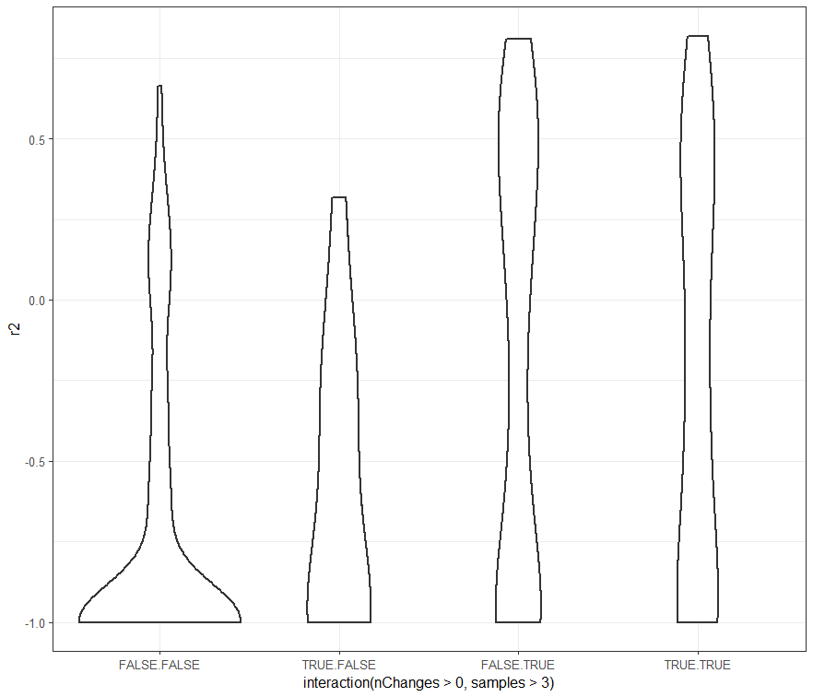
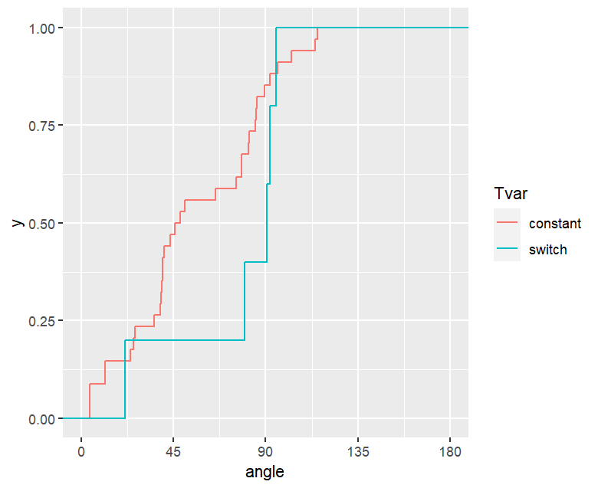
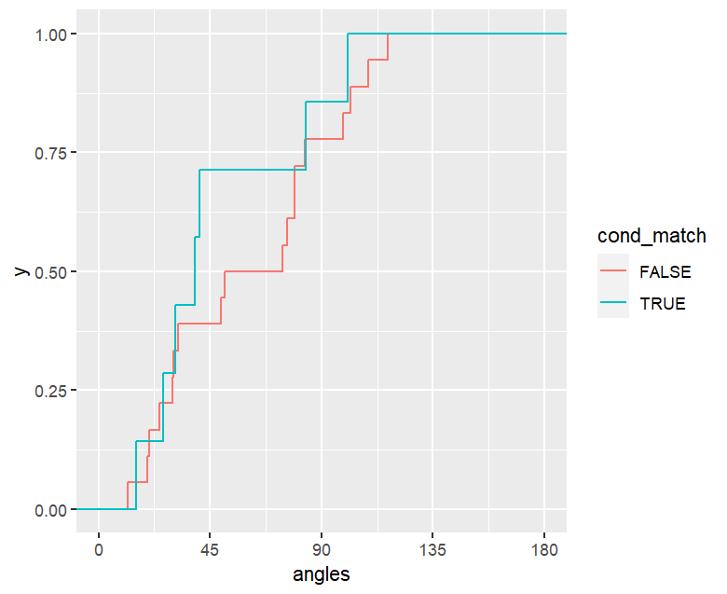

Slide 7
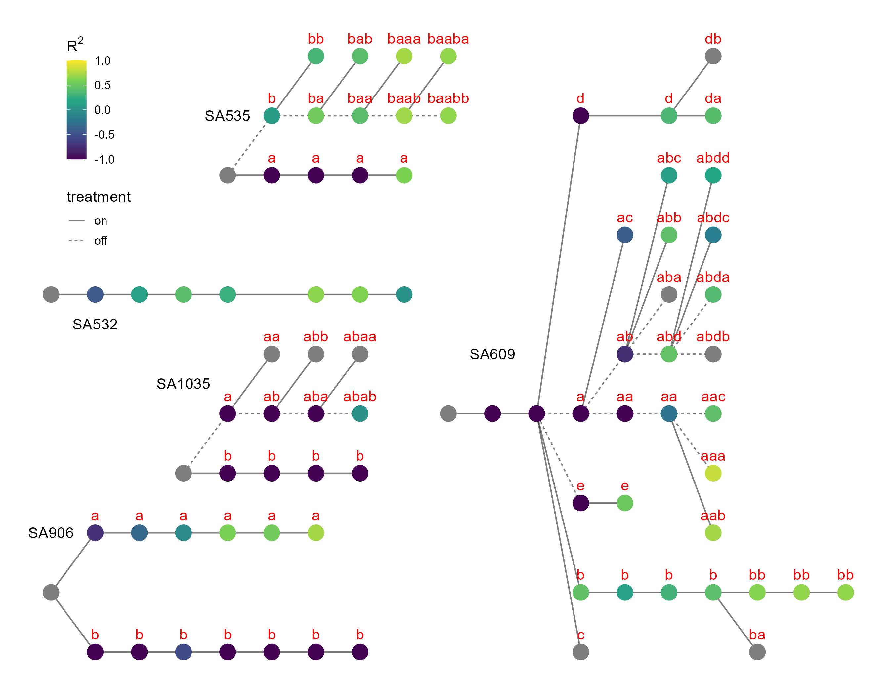
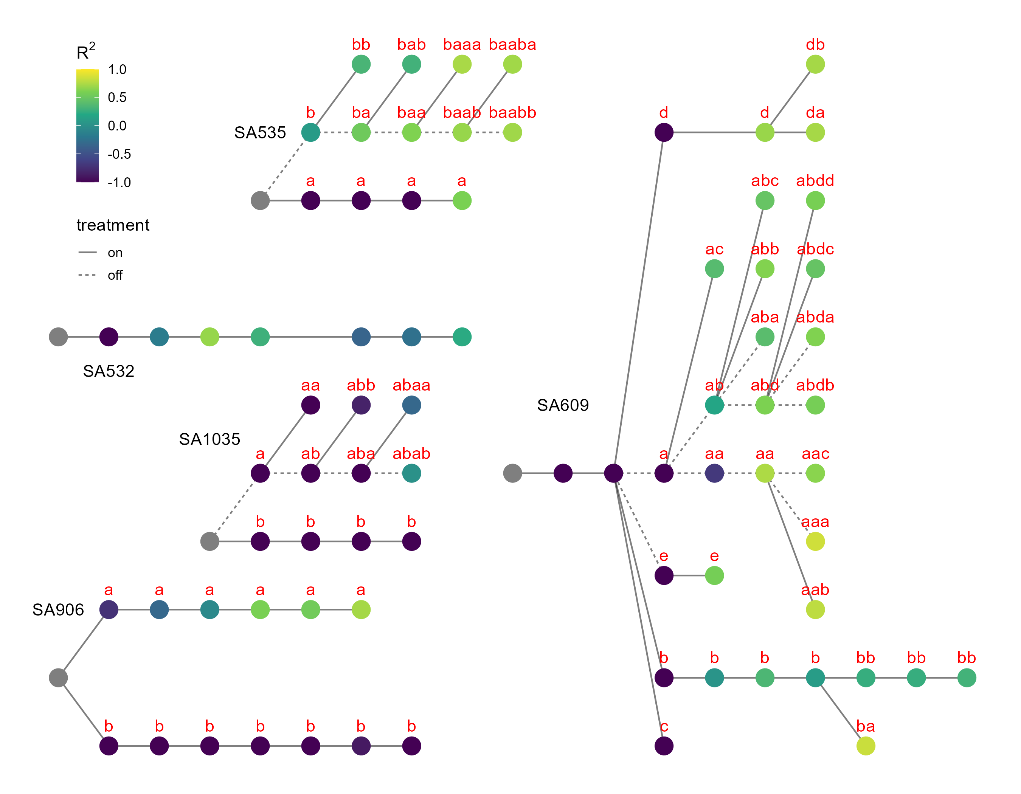
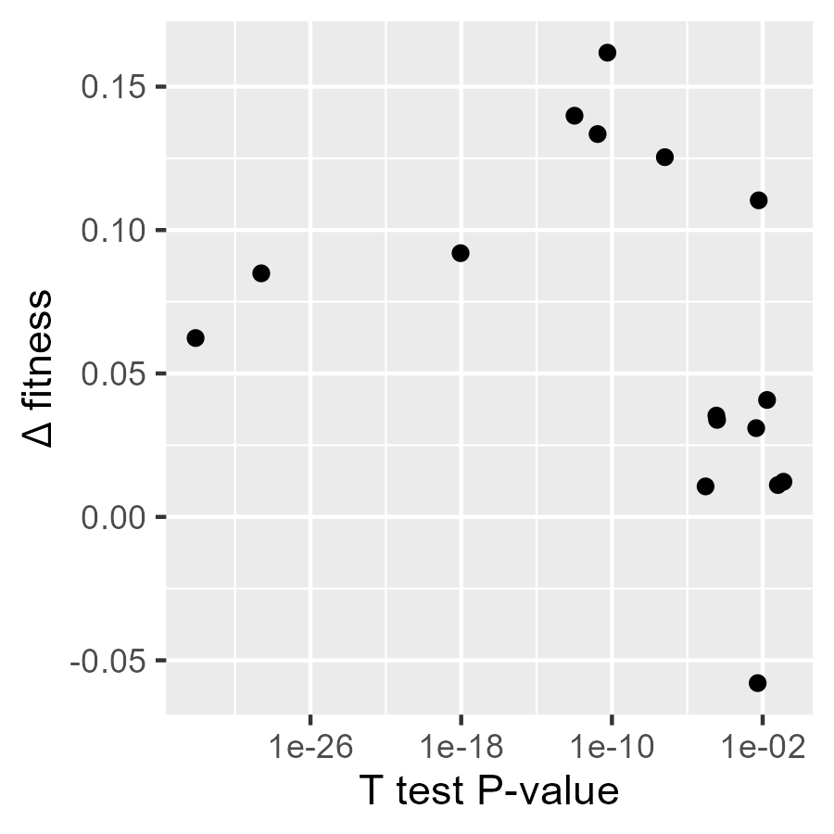
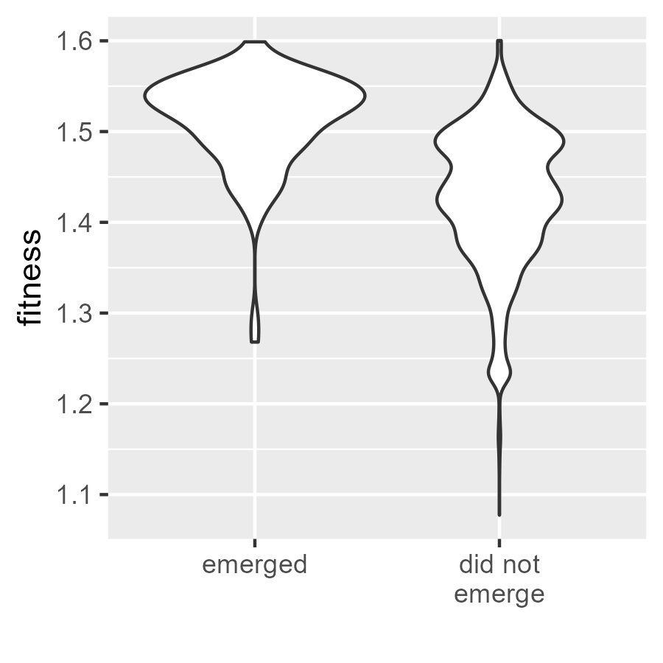
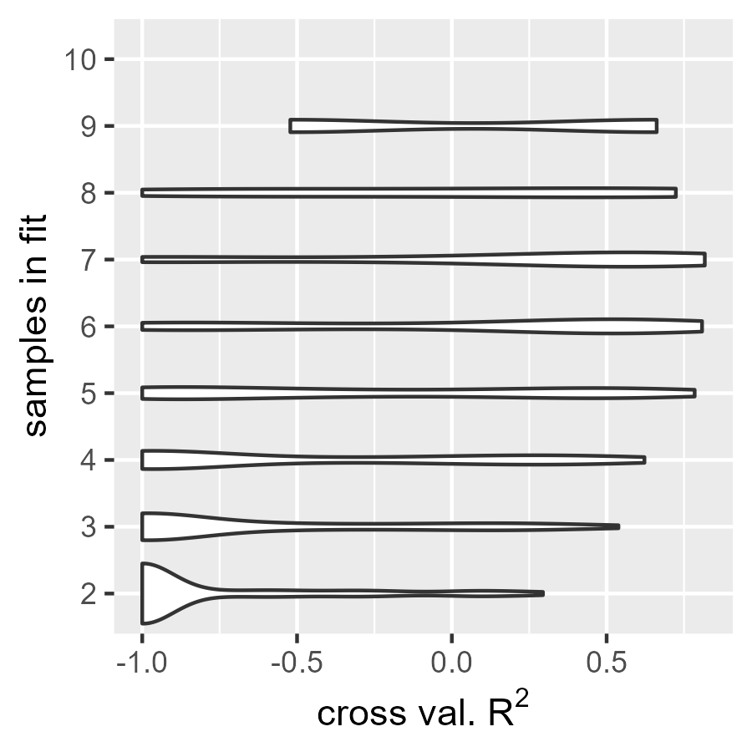
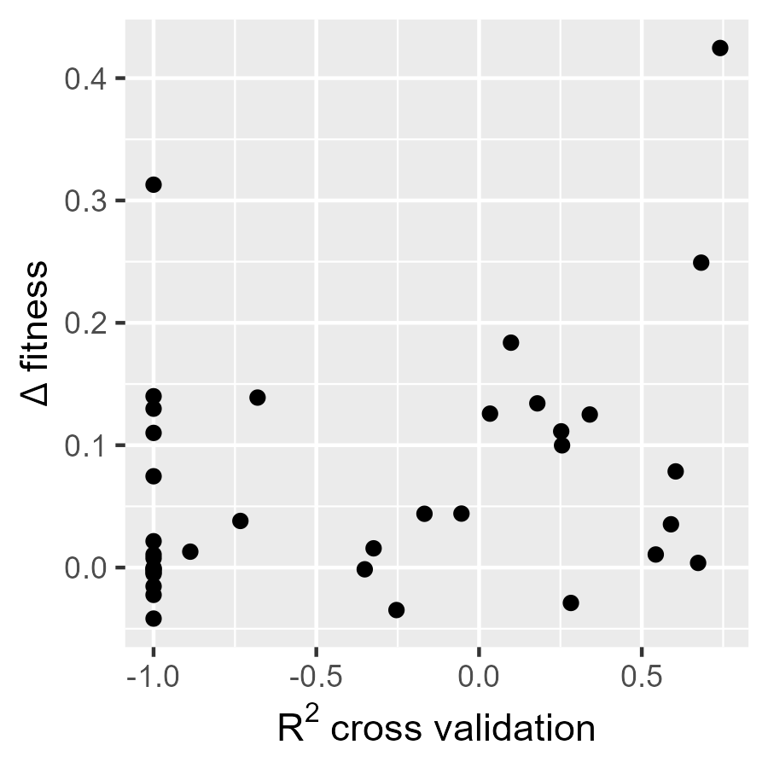
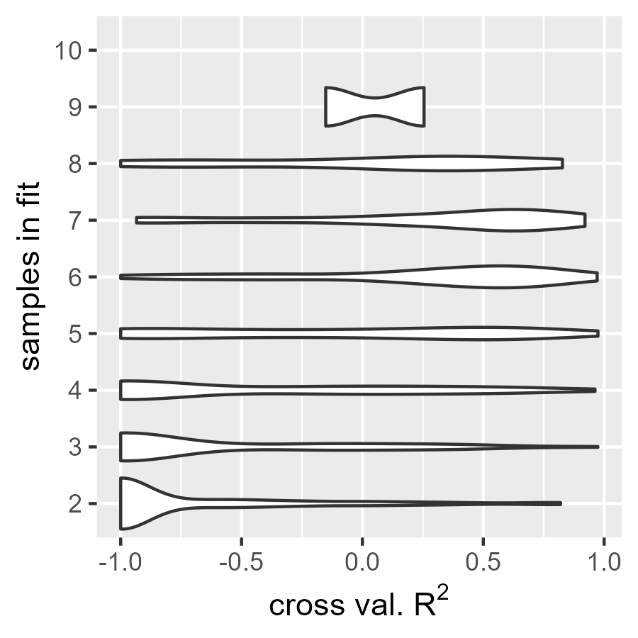
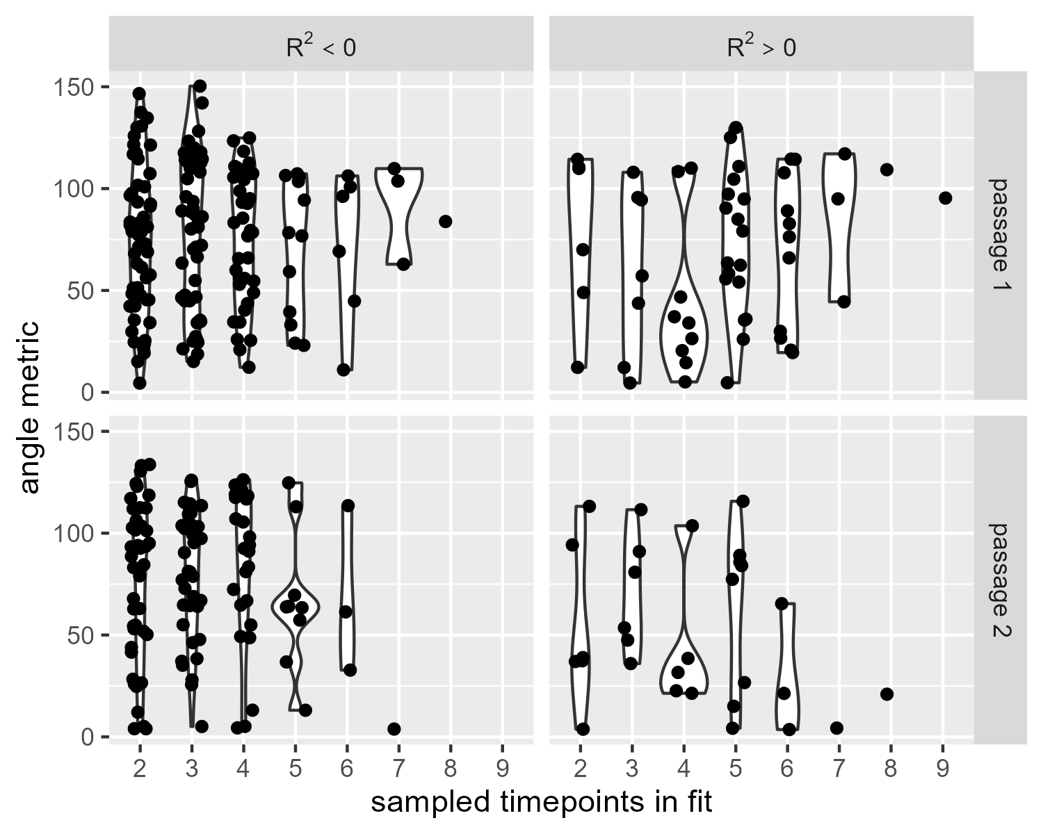
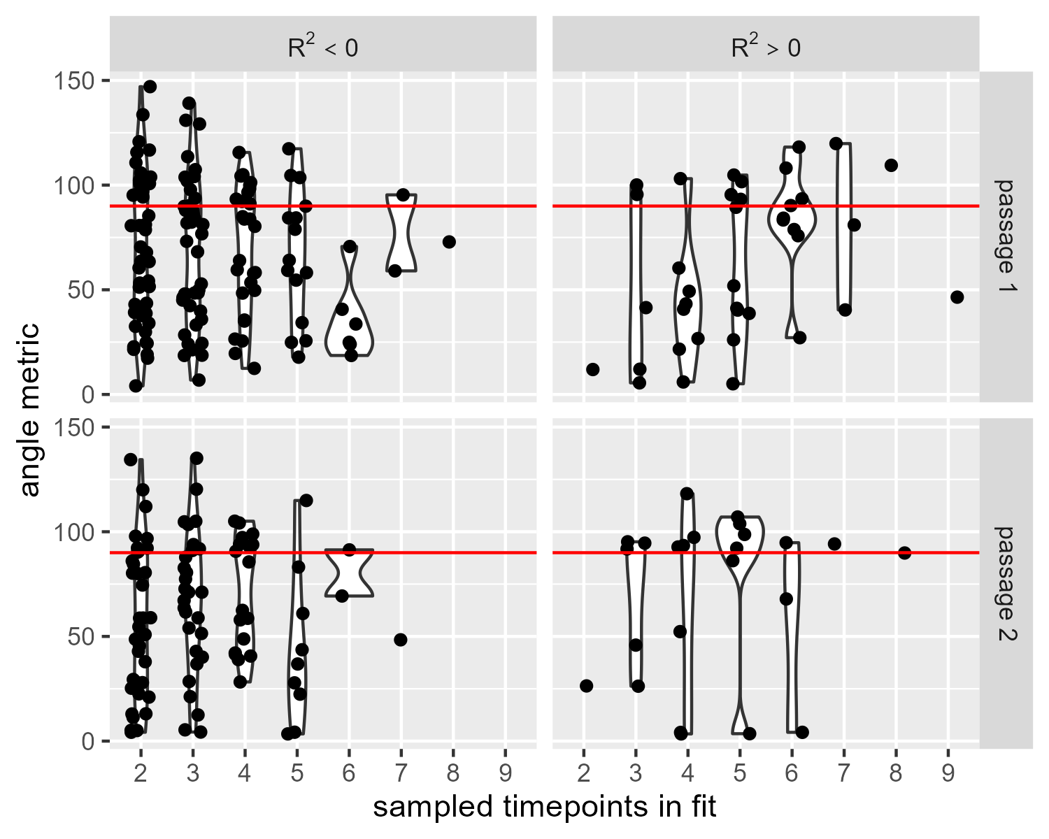
ALFA-K was fit to all lineages of data from passaging experiments by Salehi et al. A lineage was defined as two or more successive samples from the same cell line. Thus e.g. for SA532 there are 7 2-sample lineages, 6 3-sample lineages etc. Fig. A shows the relationship between samples for all 5 cell lines. Points are colored according to the cross-validation score obtained after fitting ALFA-K to the longest lineage terminating at that point. We were not able to obtain good fits to SA1035 or p53– lineage B.
Cross validation scores for all 322 lineages obtained from the data, grouped according to the number of samples in each lineage. In agreement with our ABM results, short lineages do not result in good fits. The relatively shorter length of available lineages in SA1035 may be a reason for the inability of ALFA-K to fit to this lineage.
A
B
D
C
C) Using ALFA-K fits to lineages with descendants, we simulated population evolution using the ABM and compared the predictions to the withheld samples using the angle metric. We were able to obtain good predictions for 1-2 passages ahead, with the quality of the predictions improved when there was a larger number of samples used to train ALFA-K or when ALFA-K cross validation had a positive R^2 score.
D) We tested the ability of ALFA-K to predict the emergence of new karyotypes. Using lineages with descendents, we generated candidates for emergence as 1-missegregation neighbours of the population observed in the final timepoint of the lineage. ALFA-K was then used to predict the fitness of each member of this candidate population. We reasoned that new karyotypes that emerged in the next sample should be enriched for high fitness members of this candidate population. Indeed we found that members of the candidate population that actually emerged had a higher mean fitness than those that did not emerge (positive delta fitness), i.e.

Slide 8
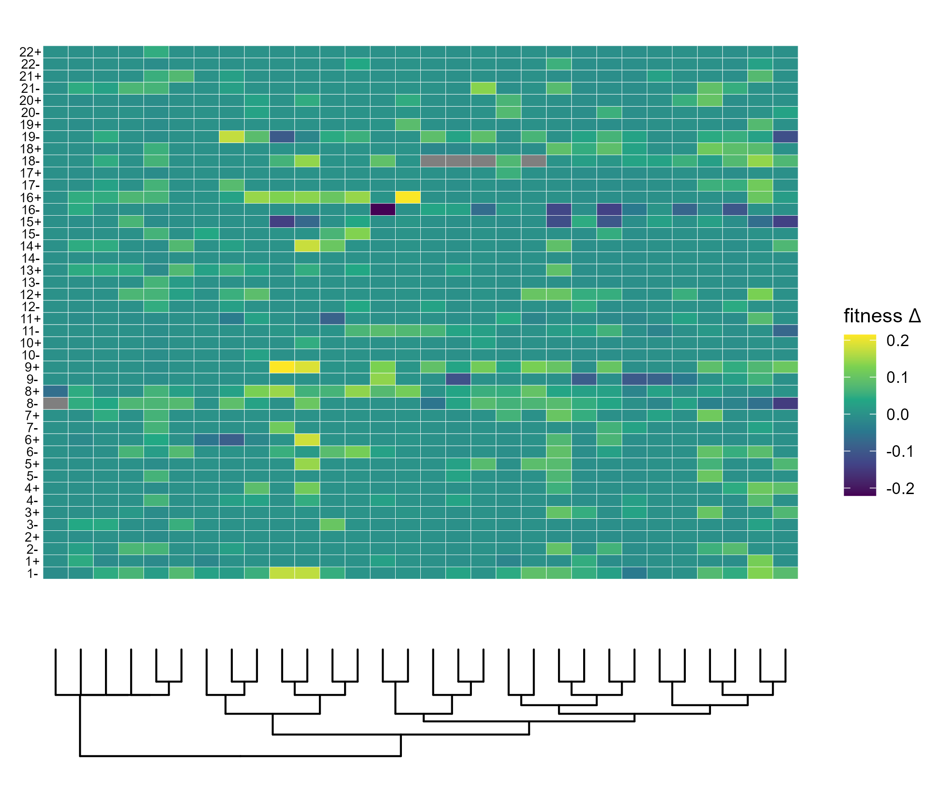
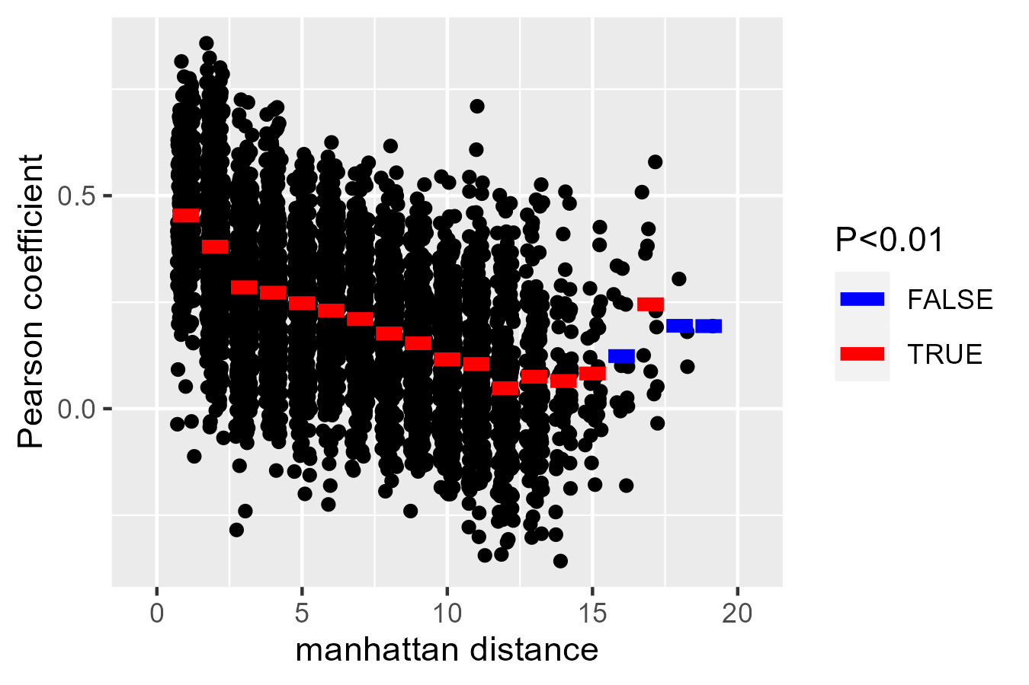
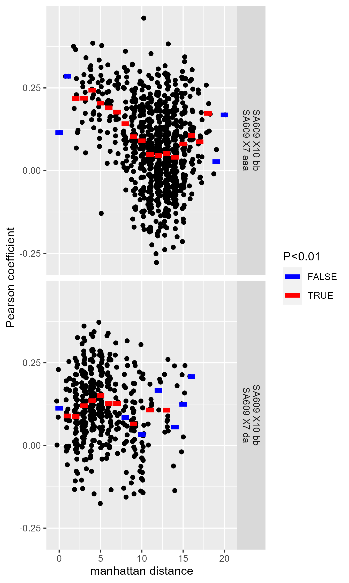
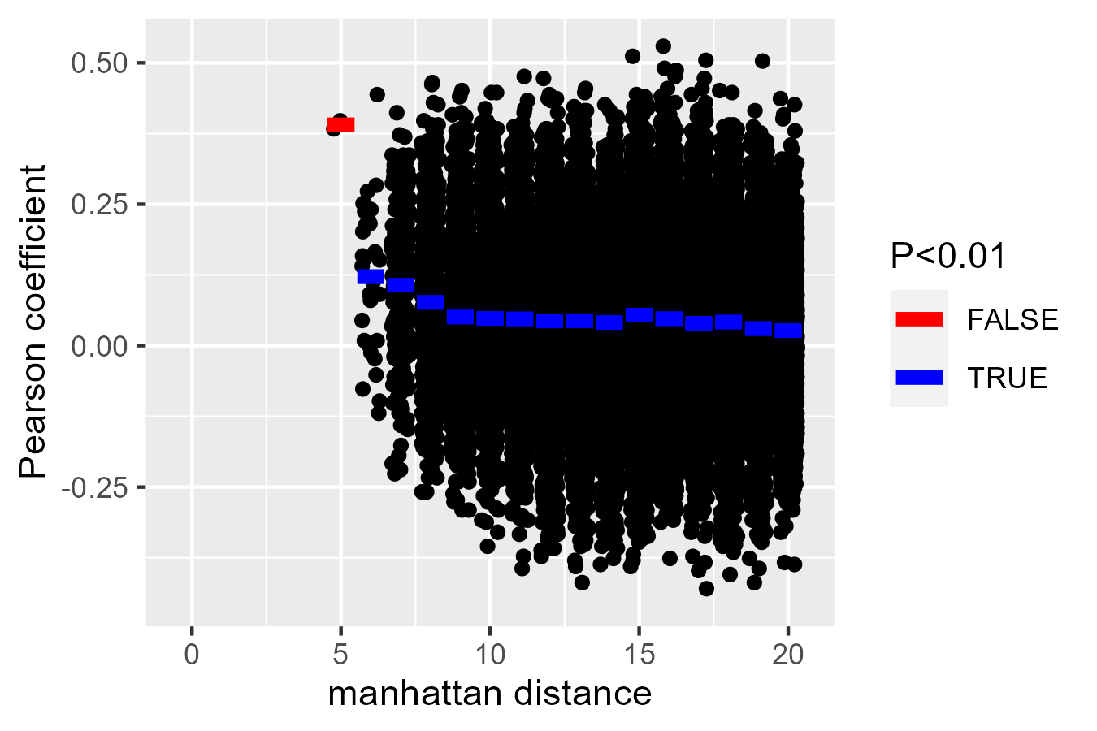
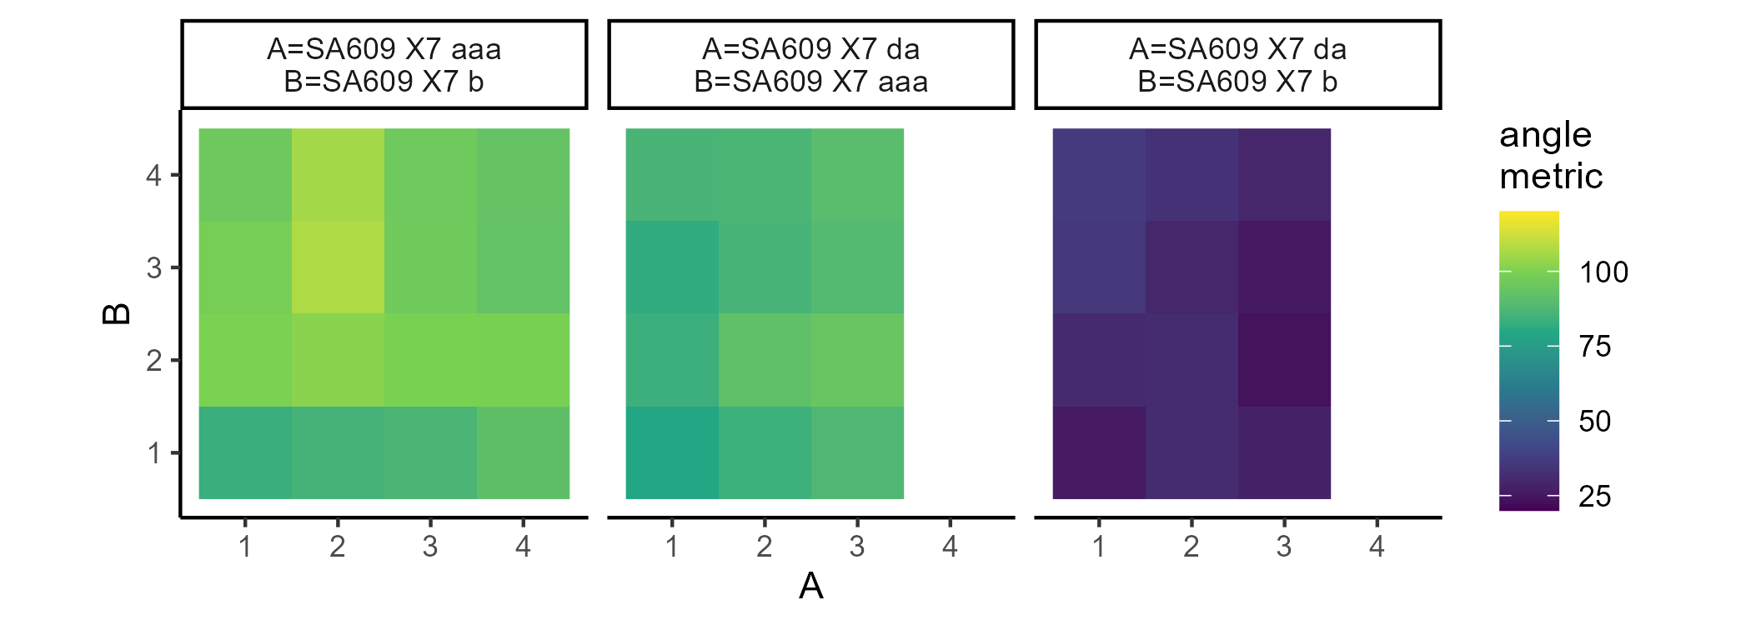
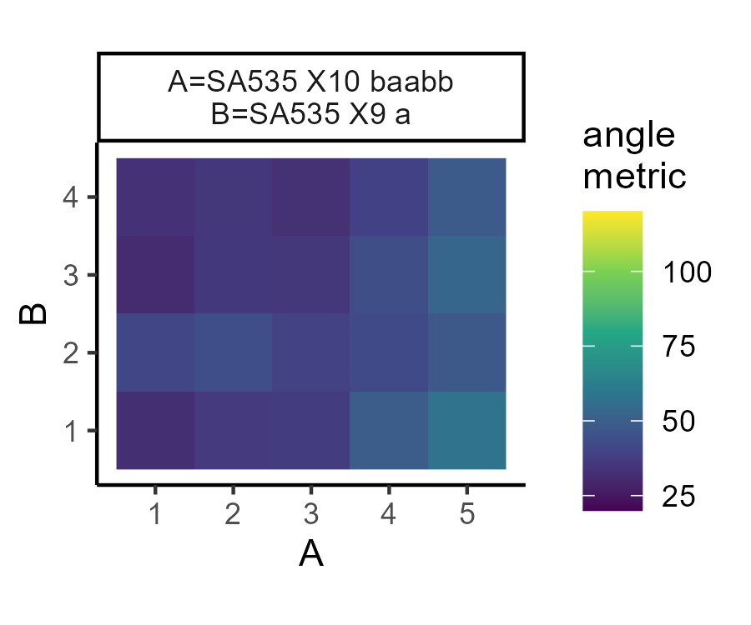
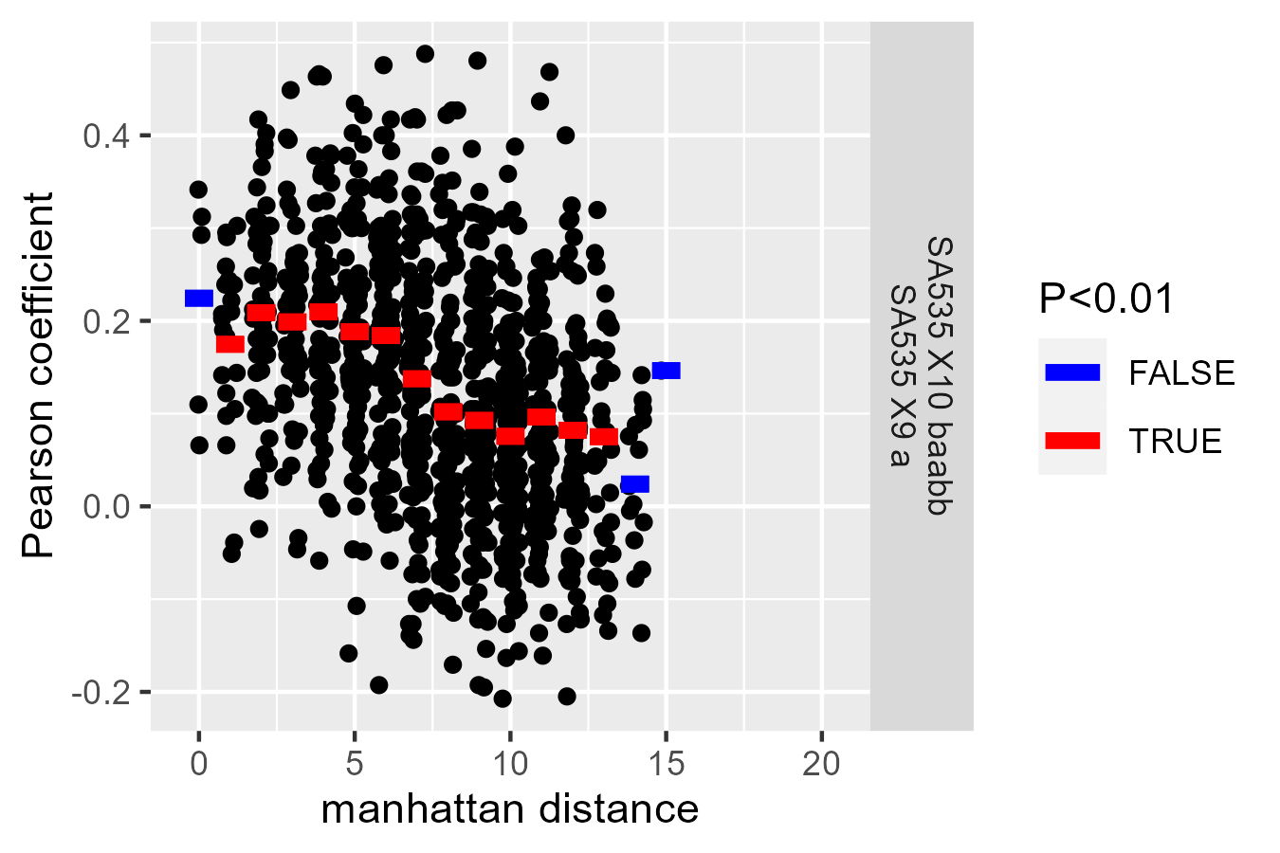

Slide 9
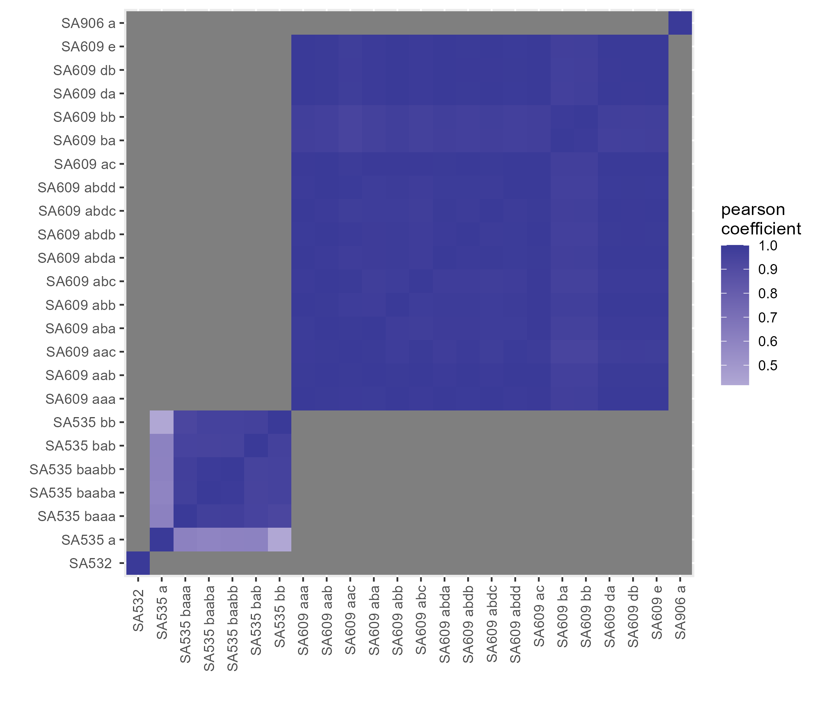
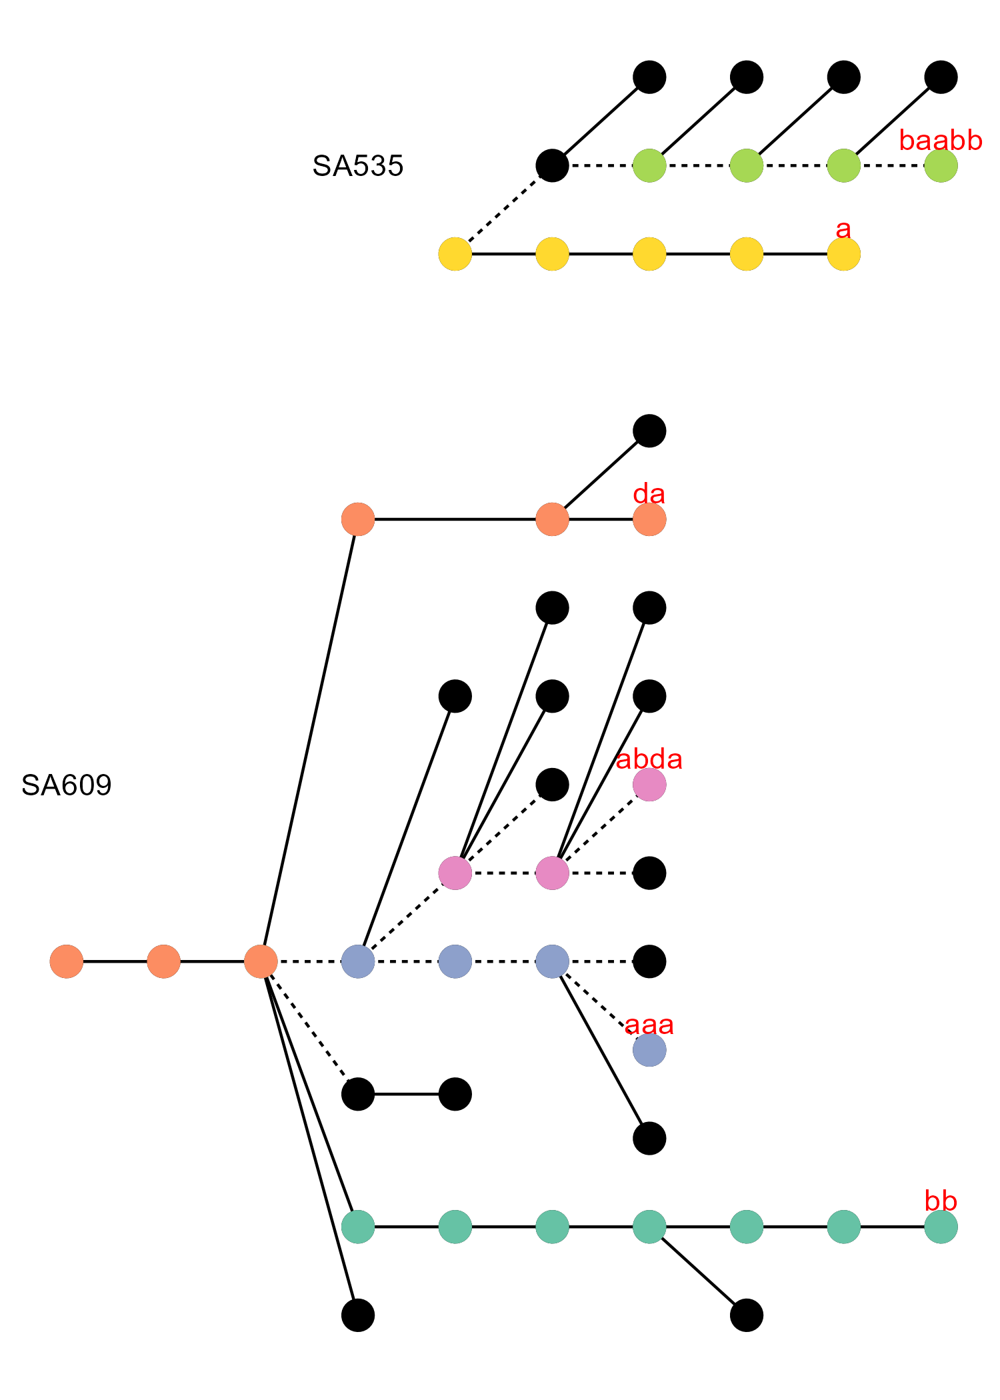
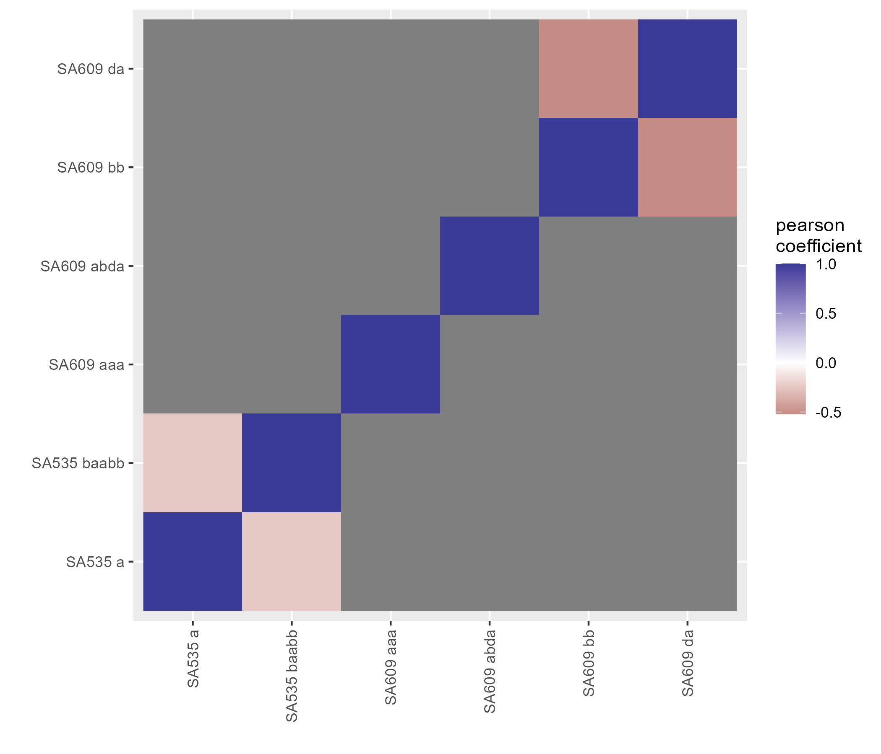
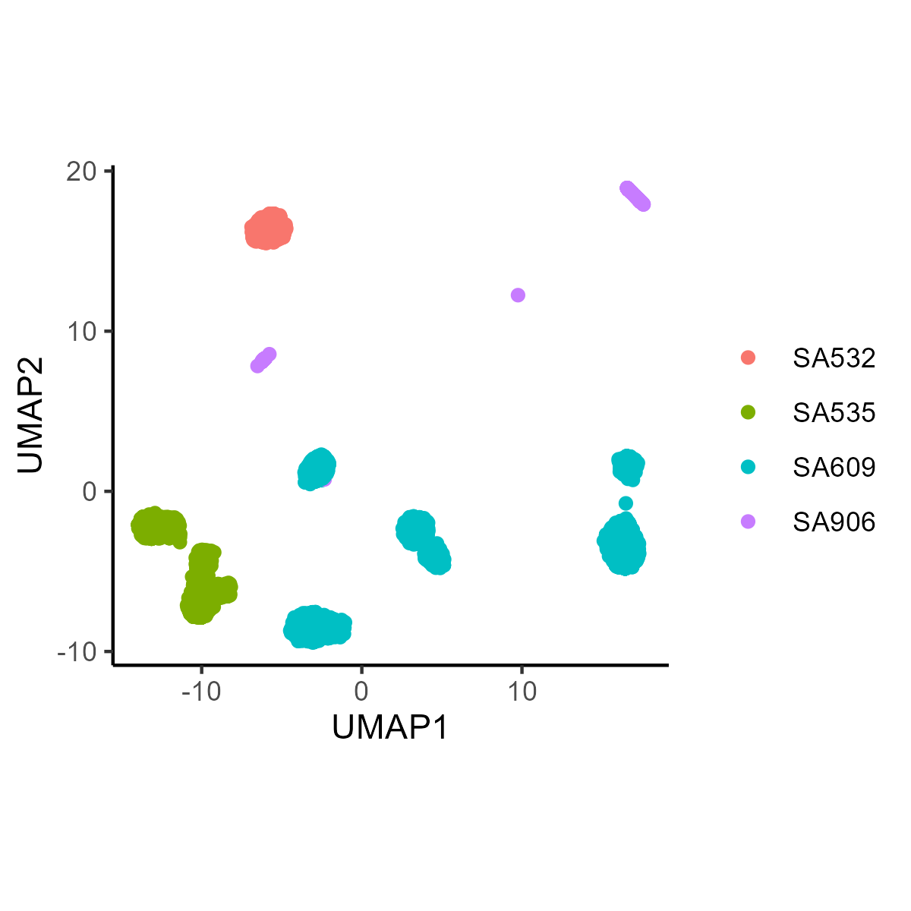
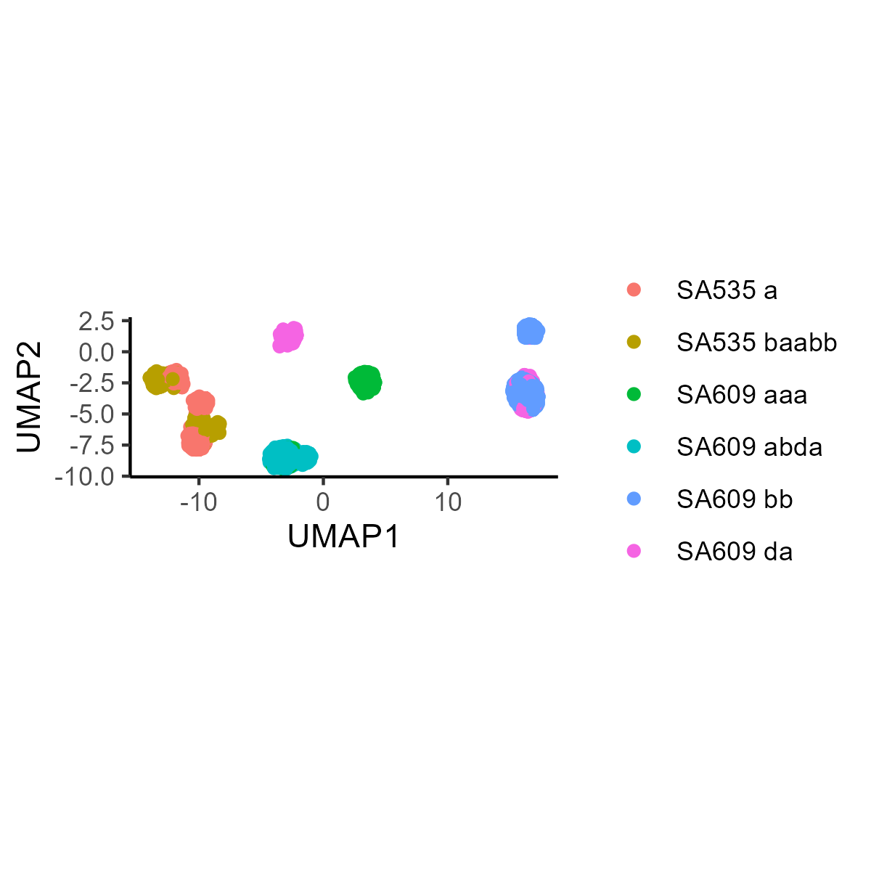
A
B
We examined correlations between fitness of karyotypes co-predicted across different landscapes. We restricted our analysis to lineages with no parents and no children (N=31) to minimize cross over between samples in lineages, and focused on the subset with R^2 cross validation scores above 0.2 (N=26). We found that Within cell lines, we found a high degree of concordance although this is perhaps to be expected since many lineages share multiple samples.
We next examined correlations between karyotype fitness predicted on selected sublineages in which treatment was entirely on or off for all samples, chosen to eliminate crossover in samples between lineages.
(&D-E) To our surprise, the fitness landscapes for the treated lineages of SA609 were too far from the other SA609 lineages and each other for any predictions to be made, indicating a rapid and non-reproducible karyotype shift in these cell lines upon cisplatin exposure. Moreover, the fitness predictions for the non-overlapping untreated lineages for SA609 did not correlate, nor did the untreated and treated lineages for SA535.
C
D
E

Slide 10
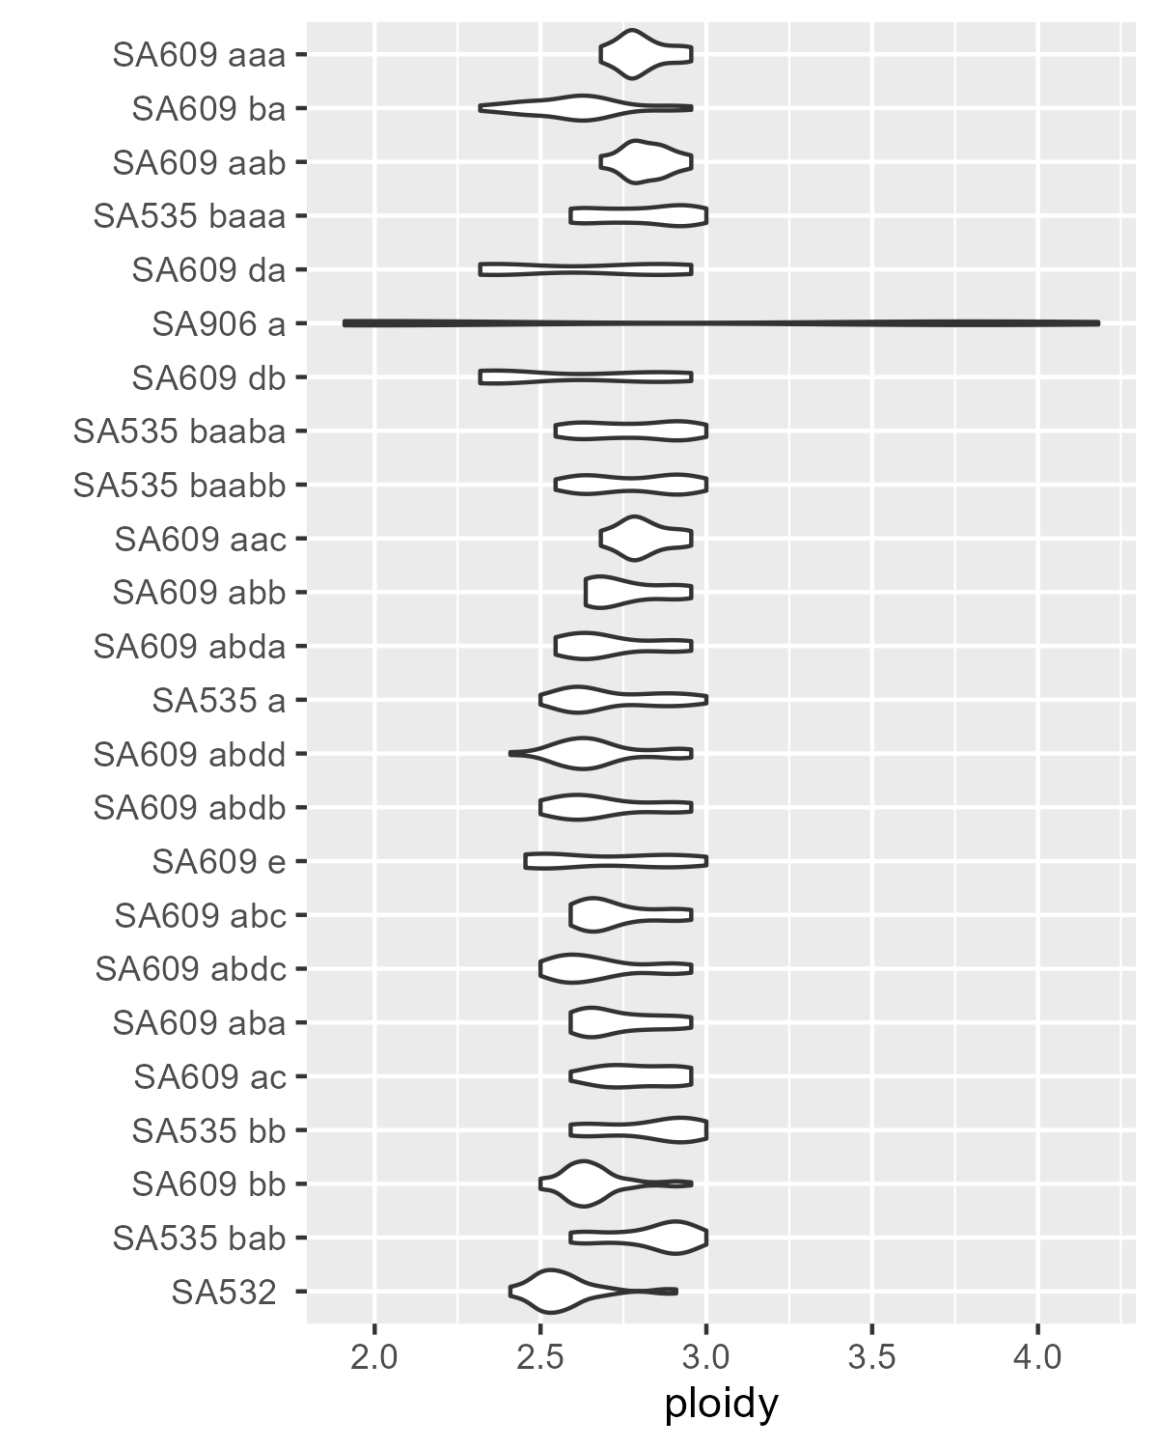
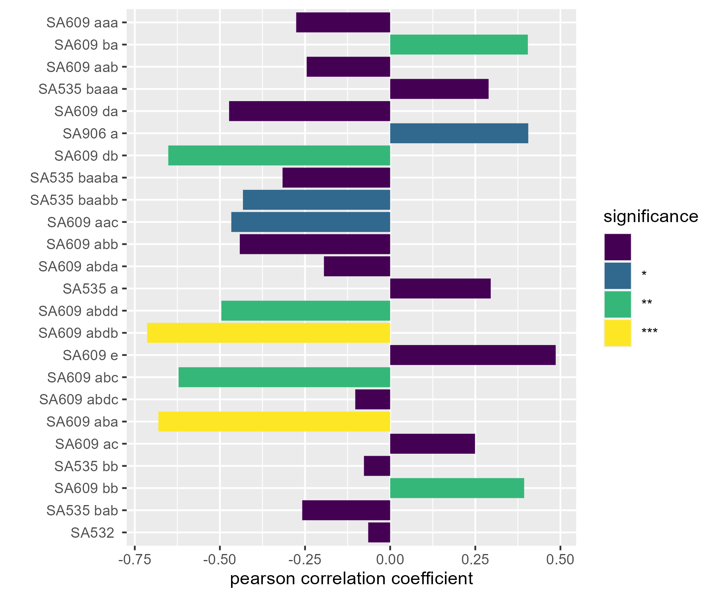
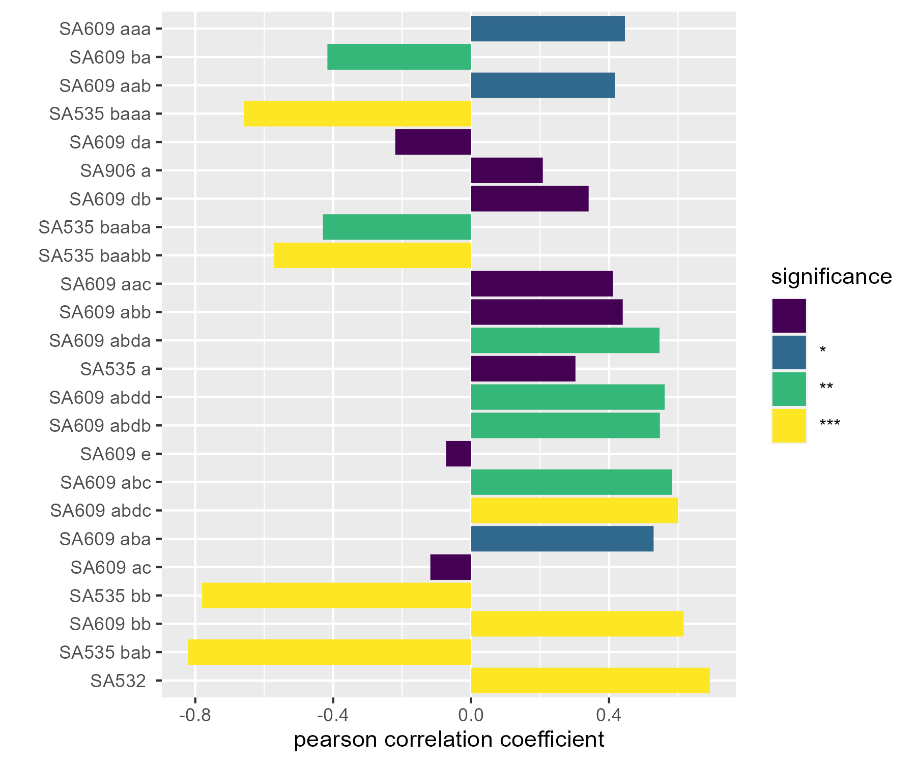
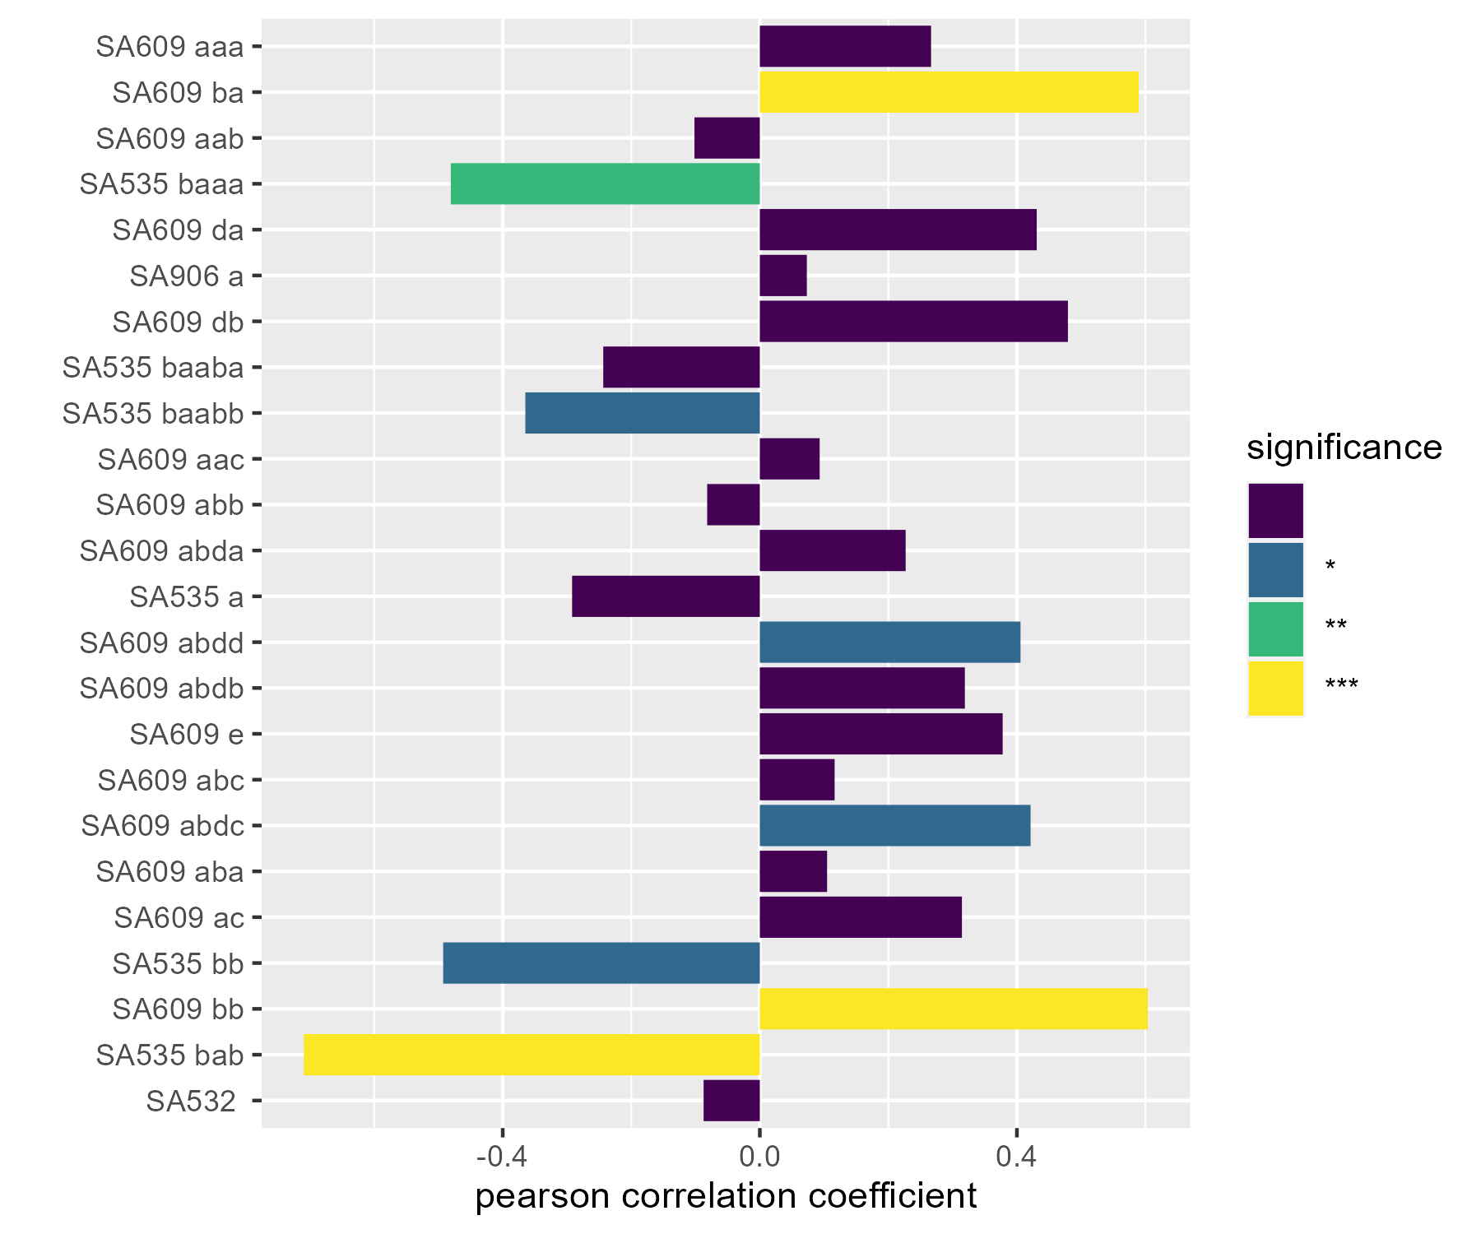
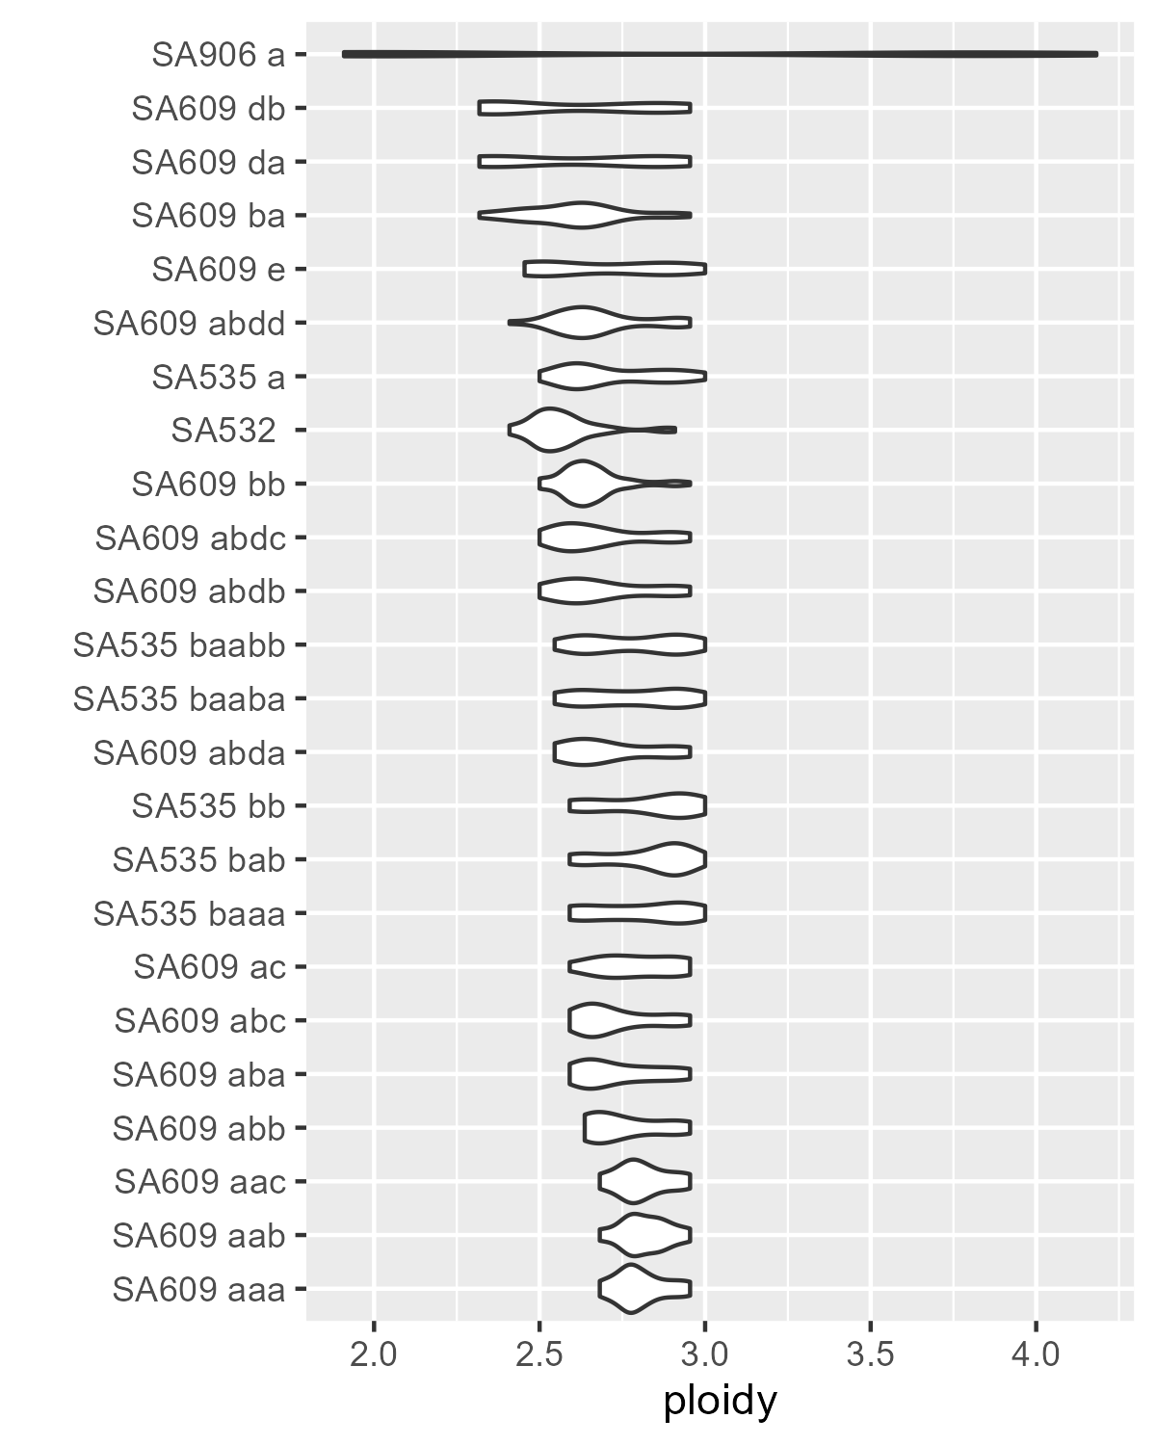
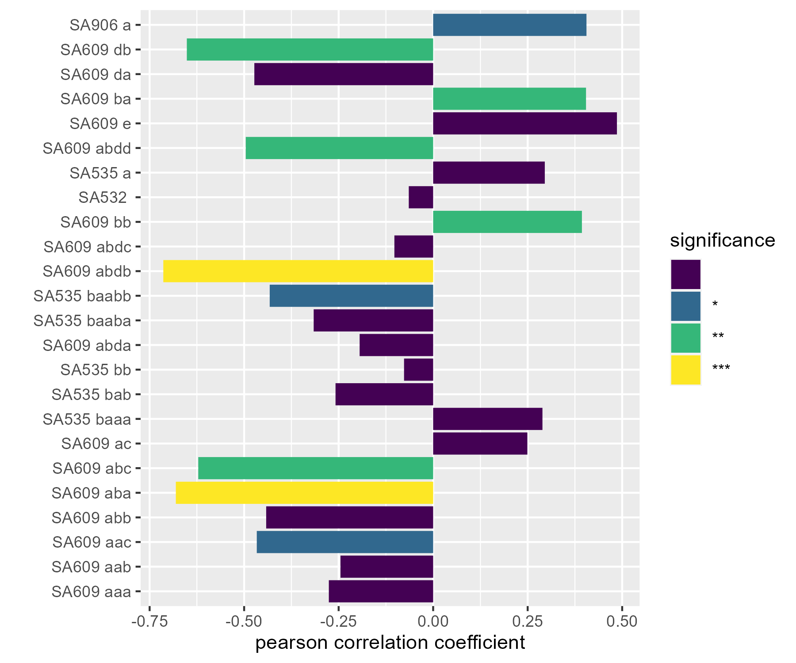
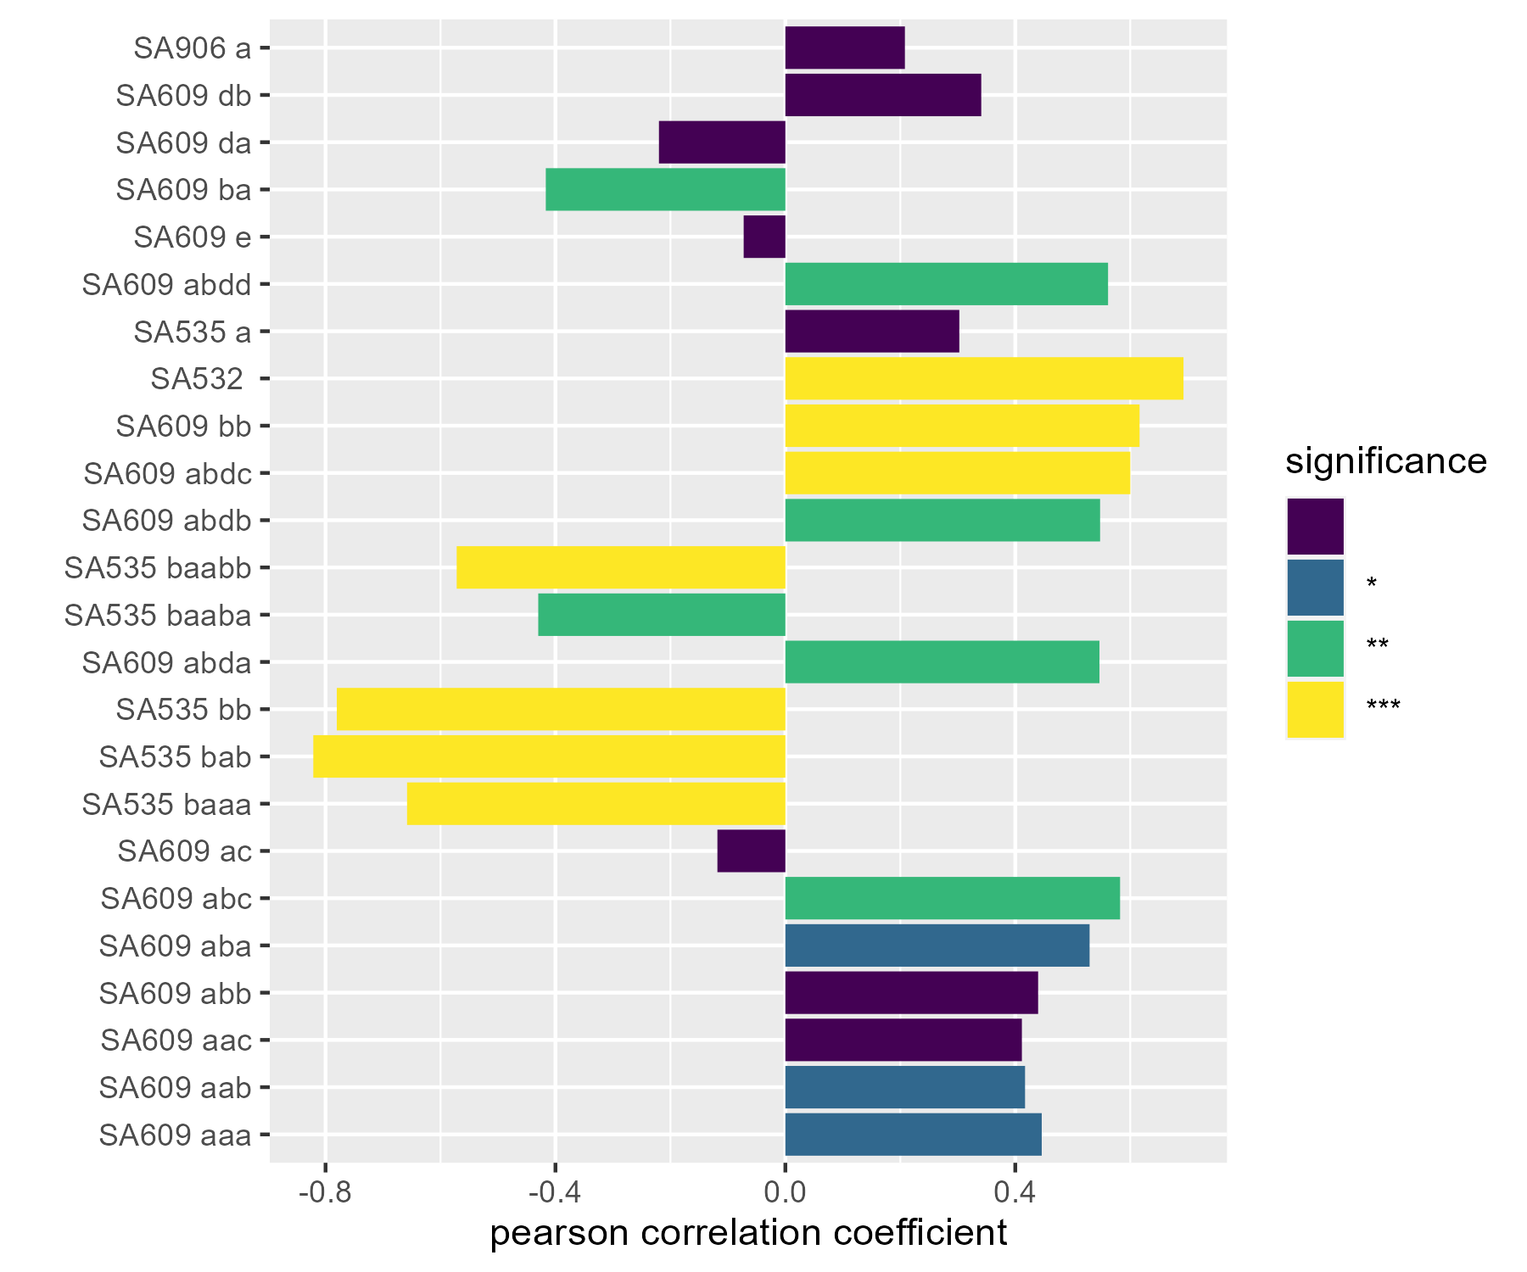
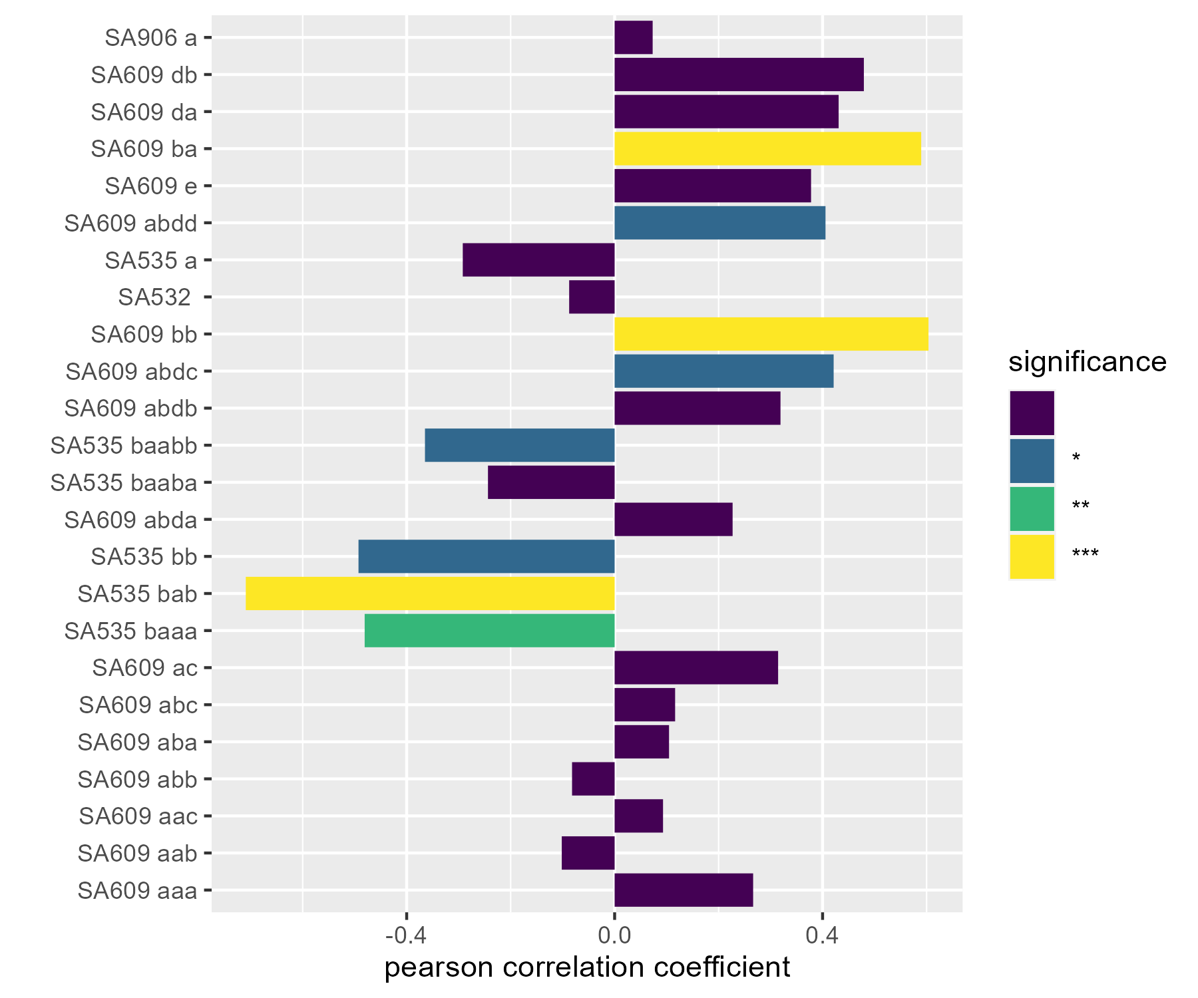
A
B
C
D
Increasing Rsquare
Increasing delta ploidy
There was some ploidy variability within the analyzed cell lines, particularly apparent for p53-/-a which underwent a whole genome doubling during the course of the passaging experiments. We investigated whether any fitness landscape features correlated with ploidy within cell lines.
The roughness metric measures the mean absolute fitness difference between a karyotype and all its neighbours. No clear relationship between ploidy and roughness was found.
The Moran metric measures the autocorrelation between karyotypes and their neighbours, with higher values indicating greater autocorrelation. Ploidy was broadly correlated with the Moran metric, except in TNBC-SA535 where it was anti-correlated.
The final metric measures the number of neighbours each karyotype has that are fitter than itself. In a scenario where mis-segregation rates were extremely low, this metric would give the number of available evolutionary paths per karyotype. This metric had a similar correlation pattern with ploidy as the Moran metric.

Slide 11
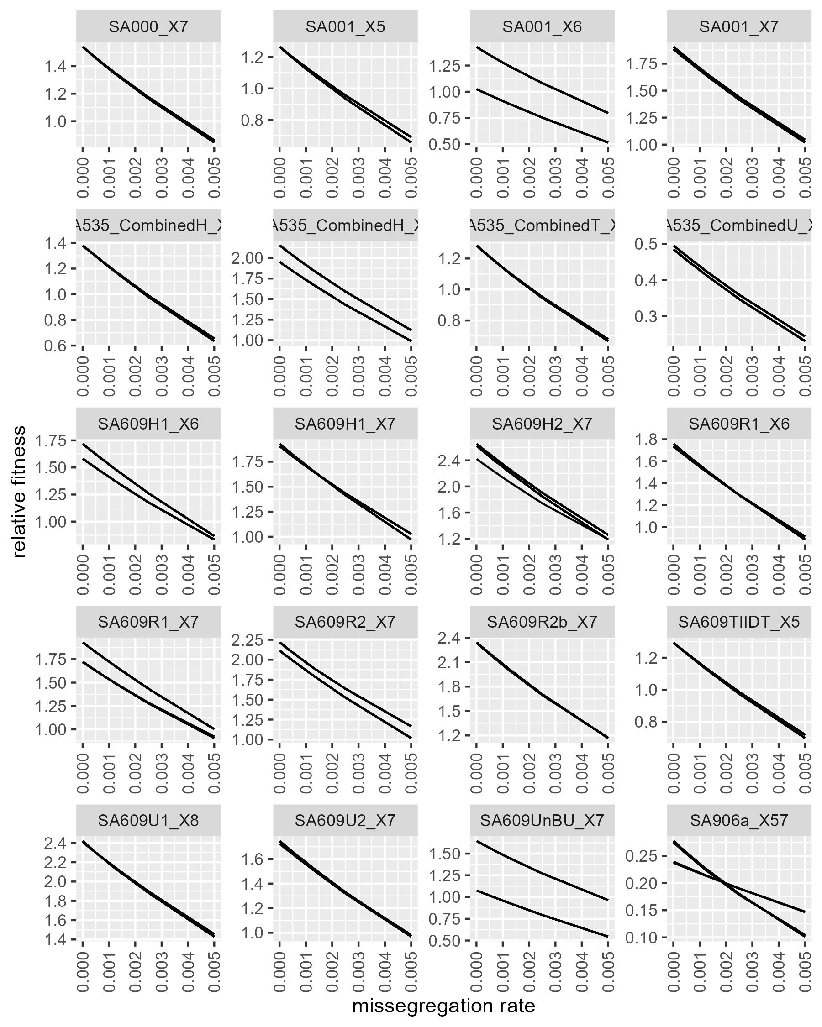
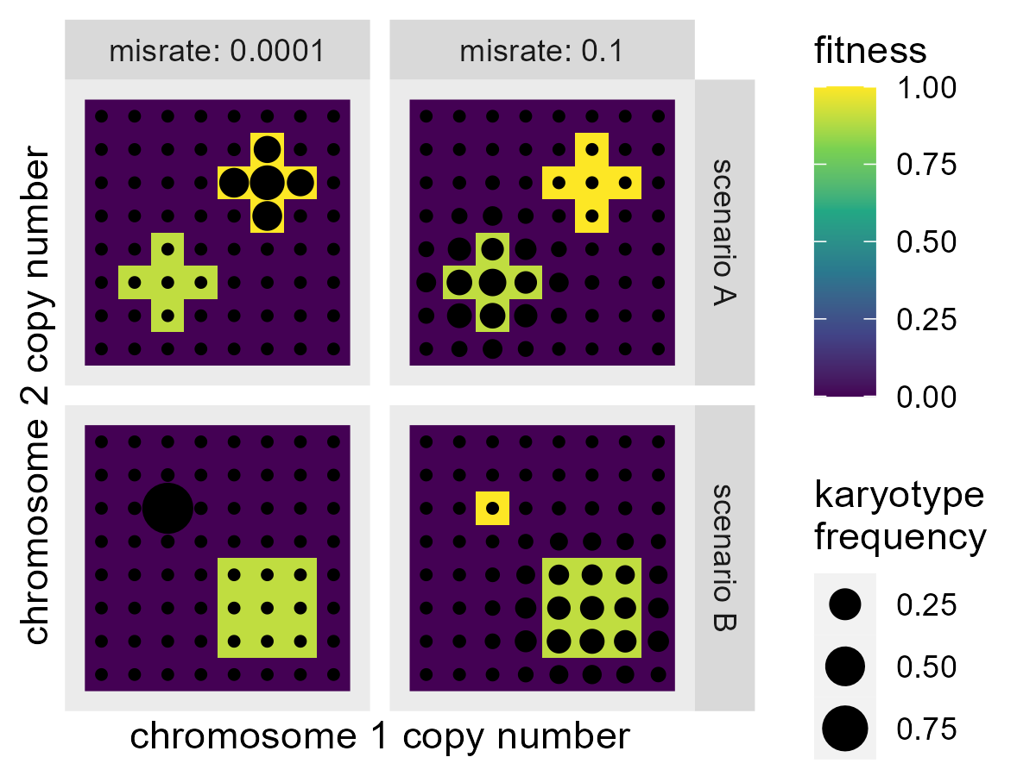
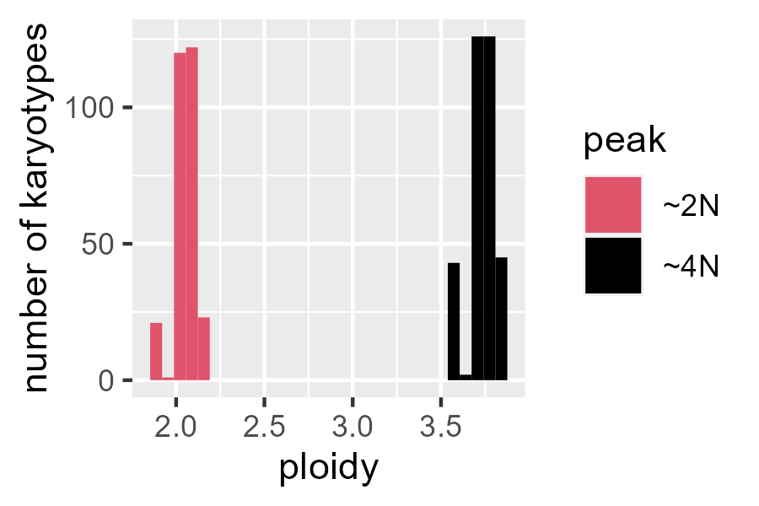
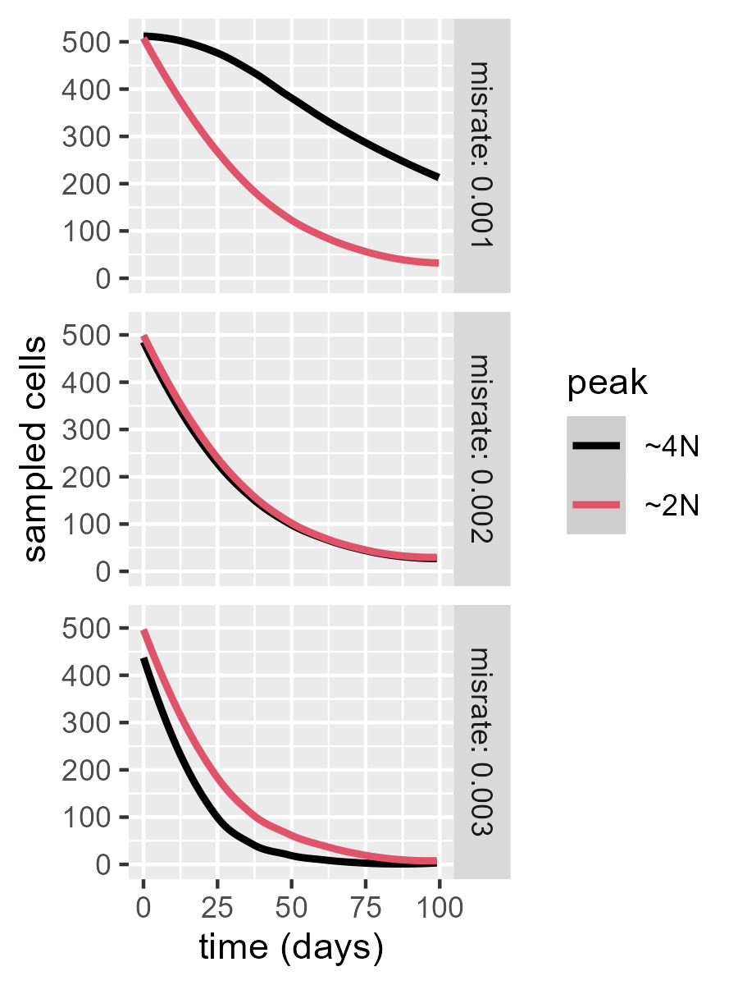
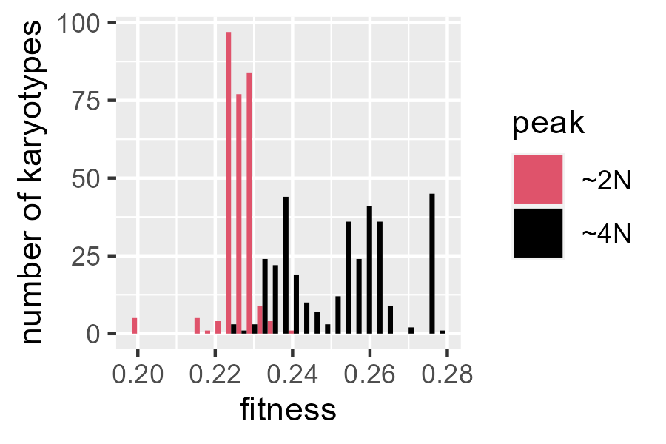
We investigated whether missegregation rates could effect how cell populations explore the karyotype fitness landscape. We imagined two ways this might happen. Firstly, if the fittest karyotype has few or no fit neighbours, it should dominate when the missegregation rate is low (bottom left). However, when missegregation rate is high enough the population may be unable to stay on the higher peak and lower, broader peaks can dominate (bottom right). Secondly, if there are two equally broad peaks and the missegregation rate is low, the higher fitness peak should dominate (top left). However, when the higher peak has a higher ploidy then increasing missegregation rate can force the population of this peak, since higher ploidy cells have more chromosome copies hence higher probability of missegregation overall (top right).
We searched for fitness peaks in our fitted landscape by identifying karyotypes that were fitter than any of their neighbours. We then merged peaks that shared any neighbours. Finally, we approximated the fitness of karyotype populations residing on each of these peaks using an eigenvalue based method. We screened for landscapes where changing missegregation rate altered the fittest peak. Of our fitted landscapes, only SA906 (p53-/-b) exhibited a significant fitness reversal based on missegregation rate.
The fitness reversal for SA906 involved two similarly sized peaks, one near diploid and another near tetraploid.
The near tetraploid peak had significantly higher fitness than the near diploid peak.
We initialized our ABM with a population split evenly between the two peaks. At low missegregation rates the ~4N peak was fittest. As the missegregation rate increased beyond the predicted fitness reversal value of 0.002, the ~2N population was fittest in agreement with the prediction.
A
B
C
E
D

